Slide 1
Evaluating your home heating needs
A SIMPLE METHOD

Slide 2
I am just a homeowner, not a heating contractor—YMMV
Disclaimer

Slide 3
Uses data on fuel bills to know heat delivered versus climate conditions and extrapolates from that to determine furnace size.
Terminology:
CCF (hundred cubic feet)
Therm (100,000 BTU; approximately one CCF)
BTU (British Thermal Unit, ~one wooden match)
HDD (Heating Degree Days)
Temperature Rise (65 – coldest temp possible)
The Formula:
BTU = Therms*100k * Eff% / HDD / 24 * 115
Simple method

Slide 4
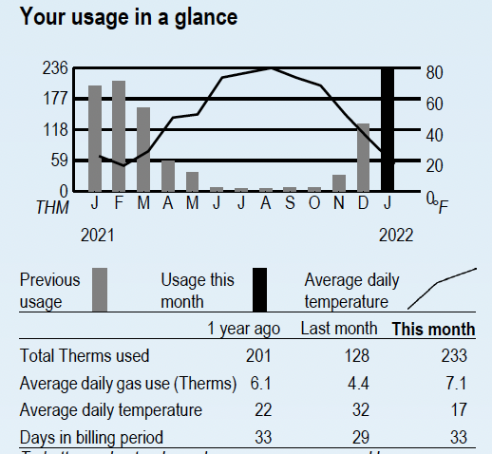
On-Bill Info
December 2021

Slide 5
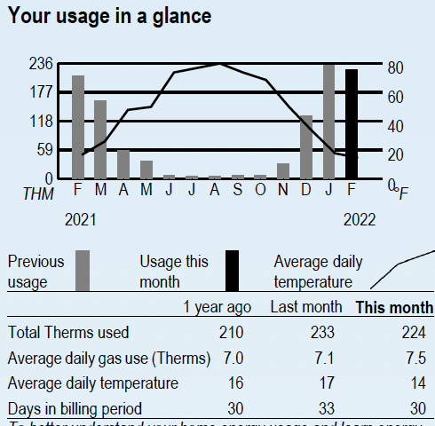
On-Bill Info
Jan-Feb 2022
Average Temp
14F, from Weather Underground
(65-14)*30=1530 HDD
My Therms for cooking etc. is ~.2/day
22700*0.9/1530/24*115=64 kBTU
22700*0.8/1530/24*115=57 kBTU
Heat Pump at 34F?
22700/1530/24*31=15 kBTU

Slide 6
Available techniques for estimating home-heating needs are simple to complex:
Square feet – Ranch vs Multi Story
Insulation Quality – R Value
Windows – Number and Quality
Doors – Number and Quality
Climate – Temperature Rise
One example of a simple online calculator:
www.calculator.net/btu-calculator.html
Complex METHODs

Slide 7
All the contractors who gave me estimates wanted to put in the same size furnace as the one I had. (Contractors never get called in the middle of the night because a furnace is too big!) Problems with that:
Furnace was short-cycling
Uneven heating
Reduced efficiency
Accelerated aging
High-efficiency furnaces were not that big
Quoted tandem furnaces
Reality

Slide 8
The Formula:
BTU = Therms*100k * Eff% / HDD / 24 * 115
Therms: stated per the billing period
Times BTU/Therm
Furnace efficiency (heat output)
HDD: Cumulative heating-days over the period
Divide by 24: HDD is per day vs. furnaces are measured in kBTU/hr
Times 115 for degrees F worst-case temperature rise
Simple method—A Closer look

Slide 9
The daily temperature high and low are averaged and subtracted from 65, which gives a rough approximation of energy consumption used widely at the macro and micro levels.
HDD presumes a target home temperature of 72F, and that an insulated home retains 7 degrees of energy from other sources.
Heating load is proportional to HDD.
What is a heating degree day?

Slide 10
Standard efficiency is 80%
Divide by .8
Actual efficiency depends on:
Optimal airflow
Duct sizes
Filter resistance
Fan speed
Vent openings
Return air
Return-air temperature (delta-T)
Internal vs. External combustion-air supply
What about furnace efficiency?

Slide 11
Not Very, but it can be improved
Hi/Low temperature averaging is crude
Other sources of heat can mess with the numbers
Electric space heaters
Air-source heat pumps have complex efficiency
Account for other uses of the fuel
Cooking, Heating water, Clothes dryer
Use summer numbers to estimate (mine’s ~0.2 therm/day)
Use as much data as you can find and try to fit a line
Understanding your furnace efficiency
Probably still better than other methods
How accurate is this?

Slide 12
Bill Middlecamp
Wjm.environment@gmail.com
952-457-7263
Q&A

