Slide 1
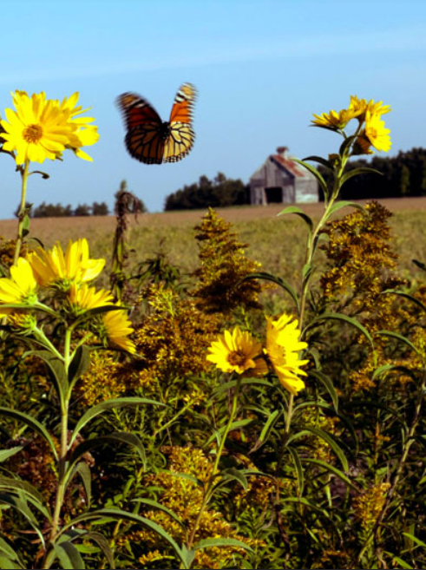
REGENERATIVE AGRICULTURE
Photo: U.S. Fish and Wildlife Service
Notes:
The Climate Reality Project, Chicago Metro Chapter
Regenerative Agriculture
Chapter Website: https://climaterealitychicago.com/regen-ag/
Date: 3/4/24.
Version 0

Slide 2
Regenerative Agriculture “Best Tool For Combating Climate Change”
Presented at Central Minnesota Chapter Meeting 4/11/24
Presenter – Don Viecelli, Chairperson of the Regenerative Agriculture Campaign Committee, Illinois Chicago Metro Chapter.
Climate Reality Project Leader Since 2020
Contact Email: viecelli@comcast.net
Chapter Website: https://climaterealitychicago.com/regen-ag/
Climate Reality Project: Chicago Metro Chapter
Notes:
My Talking Points:
Thank you for the opportunity to give this presentation on ‘Regenerative Agriculture – Best Tool For Combating Climate Change’ at the Central Minnesota Chapter Meeting 4/11/24.
My name is Don Viecelli. I’m a Climate Reality Project Leader trained in 2020 and a member of the Chicago Metro Chapter. I serve on several committees and am the Chairperson of the Regenerative Agriculture Campaign committee.
Welcome to Regenerative Agriculture “Solution to Climate Change” Presentation.
Presenter – Don Viecelli, Chairperson of the Regenerative Agriculture Campaign Committee, Chicago Metro Chapter.
Email: viecelli@comcast.net
Chapter Website: https://climaterealitychicago.com/regen-ag/

Slide 3
Covered Topics
Climate Change Is Undeniable
The Carbon Cycle
Regenerative Agriculture Definition
Carbon Sequestration Definition
RA Principles, Practices and Shifting the Paradigm
Benefits Of RA
Pace Of Change
Tilling Practices
The 2024 Farm Bill
What You Can Do To Help
What Farmers and Ranchers Can Do To Help
Q & A
Climate Reality Project: Chicago Metro Chapter
Notes:
My Talking Points:
Today, I plan to briefly cover the listed topics in this presentation:
Climate Change Is Undeniable
The Carbon Cycle
Regenerative Agriculture (RA) Definition
Carbon Sequestration Definition
RA Principles, Practices and Shifting the Paradigm
Benefits Of RA
Pace Of Change
Tilling Practices
The 2024 Farm Bill
What You Can Do To Help
What Farmers and Ranchers Can Do To Help
Time for Q & A

Slide 4
My Background
I was raised on a 160-acre family dairy farm just outside of East Lansing, MI.
I am a retired product marketing professional.
Most of my experience was in product marketing for data communication, telecommunication, cellular and wireless internet companies in Chicago area such as: Motorola Communications, Gandalf Technologies, Northern Telephone Cable Group, U.S. Cellular and Boingo Wireless.
I graduated from Michigan State University in Advertising and Marketing.
I received my M.B.A from Lake Forest Graduate School of Management.
Notes:
My Talking Points:
A little bit about my background: I was raised on a 160-acre family dairy farm in Webberville, just outside of East Lansing, MI.
I am a retired product marketing professional.
Most of my experience was in product marketing for data communication, telecommunication, cellular and wireless internet companies in Chicago.
I graduated from Michigan State University in Advertising and Marketing.
I received my M.B.A from Lake Forest Graduate School of Management.
I officially retired in 2015 and keep busy with volunteer work and my writing hobby.

Slide 5
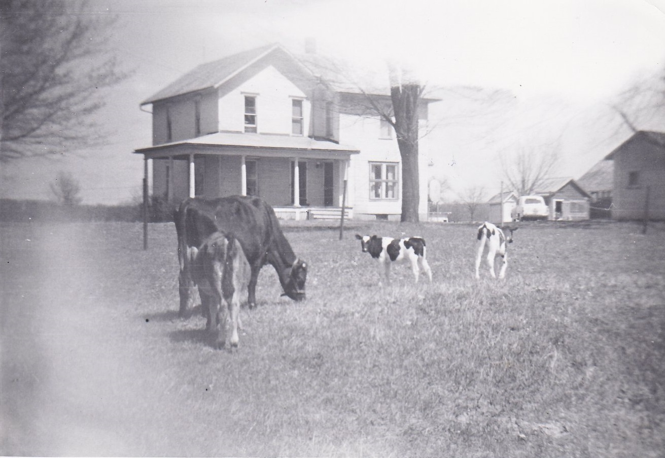
Notes:
My Talking Points:
This is my family farmhouse.
I spent 10 years helping my parents farm the land using traditional farming practices. Organic farming was not in our vocabulary. Regenerative agriculture practices were not known or practiced at the time. Farmers in the late 50s and early 60s probably would have looked unfavorably upon any farmers trying to turn away from conventional farming practices.
This was my family’s farm around 1960. We had 160 acres that include around thirty acres of woods and wetland.
My family moved from a suburb in Detroit to the farm in 1956. We raised milking cows, pigs, goats and horses. We planted corn, wheat, rye, oats and clover or alfalfa for the cows. It was a traditional family farm with around 110 acres of tillable land. I spent 10 years of my life farming before leaving for college. I never thought I would be involved with farming again. My father would be amazed at what is happening with farmers and ranchers today.

Slide 6
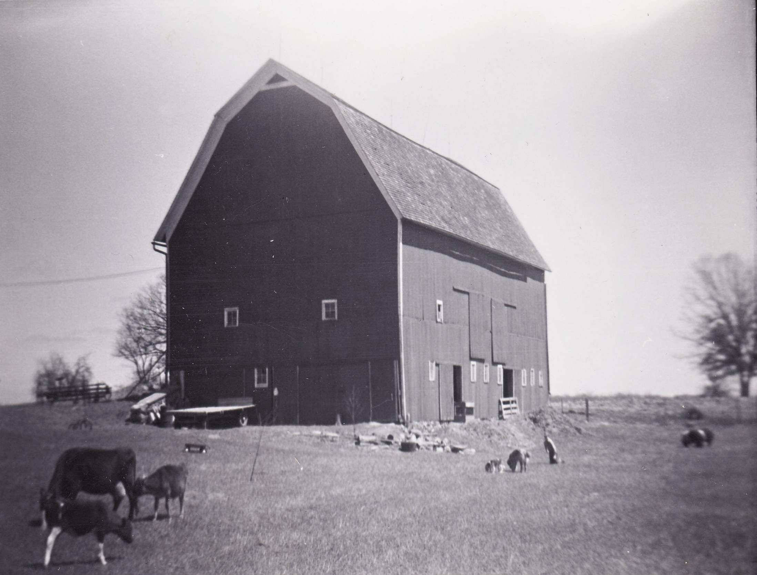
Notes:
My Talking Point:
There was no emphasis at all on regenerative farming practices as we know it today. Climate change was not on anyone’s radar screen. Soil health was not the primary focus of farmer’s concern at the time, only how much yield per acre could be achieved on the land.

Slide 7
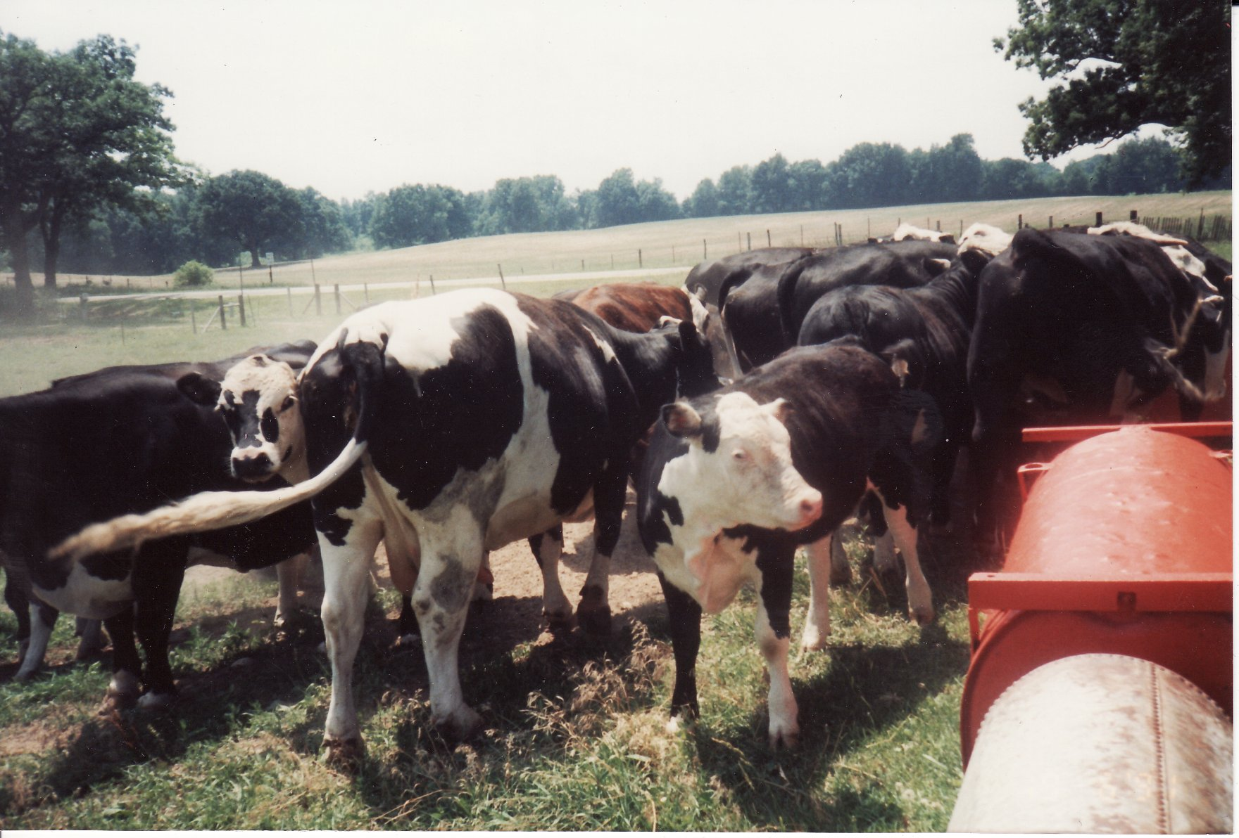
Notes:
My Talking Points:
After I went to college, my father switched from dairy cows to beef cattle. He sold a few beef cattle each year for tax purposes. He ended up have some of the oldest cows in the state. Michigan State University found out and came out to look at them since most dairy cows and beef cattle lived less than 5 years. Some of the cows were over ten years old.
The productive lifespan of average cows is between 2.5 and 4 years in most developed dairy industries. Cows calve for the first time at 2 years of age, which brings their total lifespan from birth to death between 4.5 to 6 years. The natural life expectancy of dairy cattle is approximately 20 years.
Age at slaughter “typically” can be from 12 to 22 months of age for the high-quality grade market. The reason for the range in age is that some calves are weaned and go directly to a feeding facility and are finished for slaughter.
Many beef, pork, chickens and turkeys today are raised in large Confined Animal Feeding Operations (CAFOs) which do more harm than good to our environment.

Slide 8
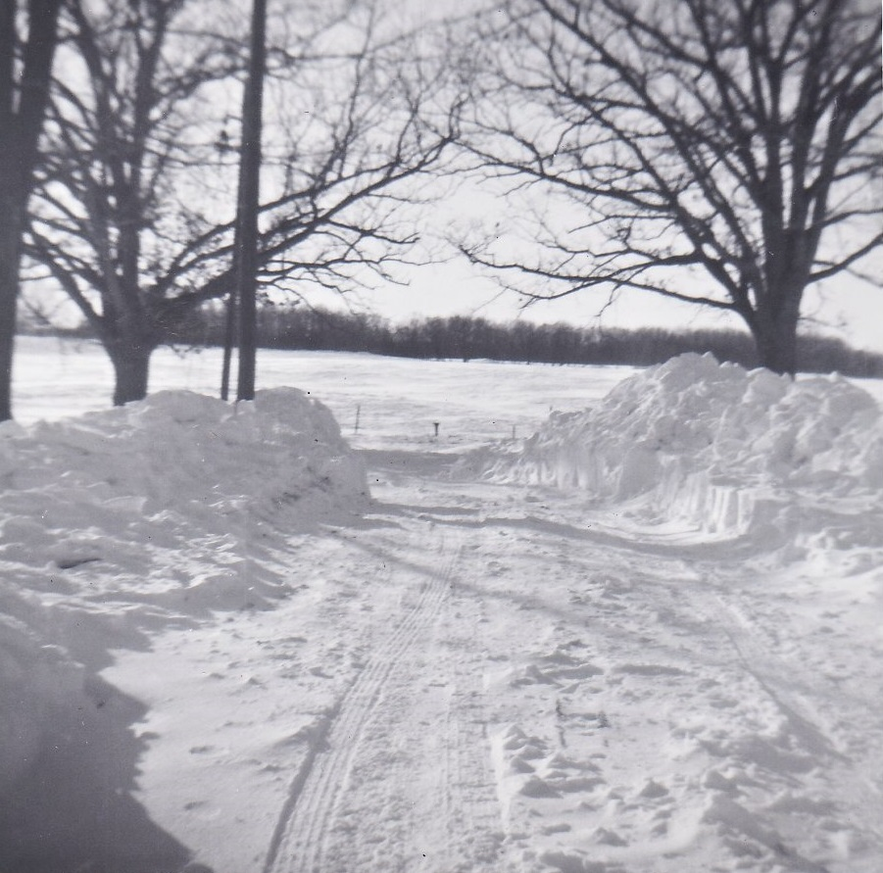
Notes:
My Talking Points:
Now, I would like to focus on climate change. When I was growing up in the 50s and 60s on the farm, the climate was predictable! Then it started to change.
The 1967 blizzard caught many Michigan residents off guard. In several locations, the temperatures were in the 50s and 60s, and then a couple of days later on Jan. 26 and 27, the blizzard dumped lots of really heavy snow in a relatively short period. In Lansing, the temperature was 66 degrees on Jan. 24, 1967. Two days later, 24 inches of snow had fallen.
I remember when winter was cold and long, with 40 mile an hour blizzards that would last all day, leaving snow drifts 10+ feet high on either side of the road. We would dig tunnels in the snow drifts for fun in spite of the danger.
In the fall, starting in October, we would get rain drizzles that lasted for days. Once, it didn’t stop for two weeks, on and off.
In the spring, it was cold until end of May, then turn warm. Seasons were more predictable and operated like clockwork.
In the summer, it would get hot and humid, but not last very long. We had a saying, if you don’t like the weather, wait ten minutes. Sunny days never lasted three days in a row.

Slide 9
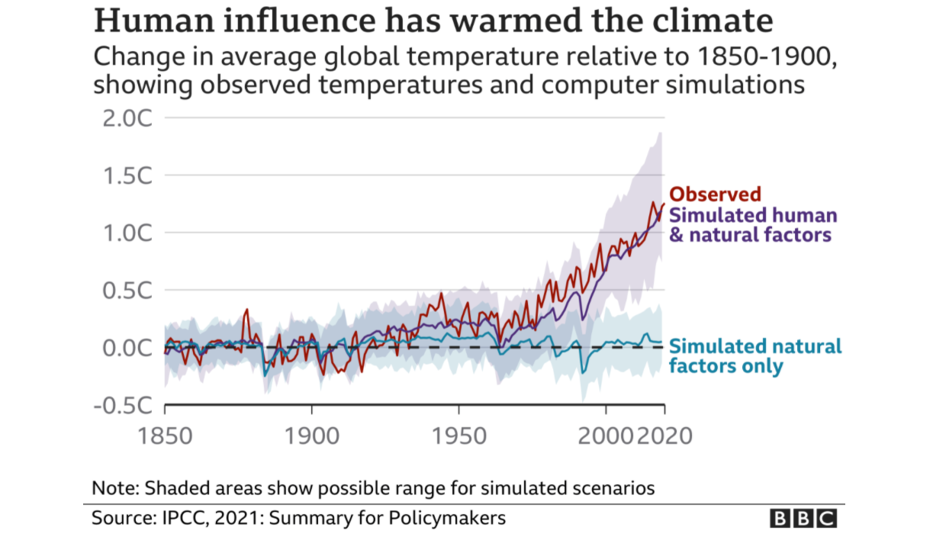
IPCC Climate Report: “Code Red For Humanity”
Notes:
My Talking Points:
The latest report from the UN’s IPCC, Intergovernmental Panel on Climate Change, states, unequivocally, that humans are the reason our climate is warming the planet.
They call it a “Code Red For Humanity”!
This chart shows our average surface temperature has risen 1.2 degree Celsius since 1850.
The IPCC goal is to keep the temperature from rising over 1.5 degrees Celsius by 2025 to prevent irreversible climate change events.
The sober assessment of our planet's future has been delivered by the UN's Intergovernmental Panel on Climate Change (IPCC), a group of scientists whose findings are endorsed by the world's governments.
Their report is the first major review of the science of climate change since 2013. Its release comes less than three months before a key climate summit in Glasgow known as COP26. COP26 is a recent annual UN climate change conference. COP stands for Conference of the Parties, and the summit was attended by the countries that signed the United Nations Framework Convention on Climate Change (UNFCCC) – a treaty that came into force in 1994.
In strong, confident tones, the IPCC's document says "it is unequivocal that human influence has warmed the atmosphere, oceans and land".

Slide 10
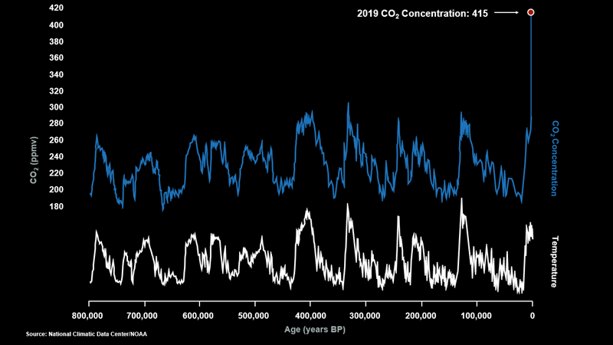
Notes:
My Talking Points:
Carbon dioxide (CO2) emissions is the reason the atmosphere is warming. These levels have already risen to historic levels.
This chart shows that CO2 levels were consistently in the 260-300 ppm range over the last 800,000 years.
This data is from ice core samples that show historical CO2 concentration levels.
Everything changed with the beginning of the industrial age, and especially in the last 70 years since WW2.
DESCRIPTION: Rising levels of CO2 graph.
Notes: But even if we stop all CO2 emissions right now, the CO2 levels have already risen dramatically and we will need to sequester carbon from the atmosphere in order to prevent continuing natural disasters from climate change.
Source: National Climate Data Center, NOAA.

Slide 11
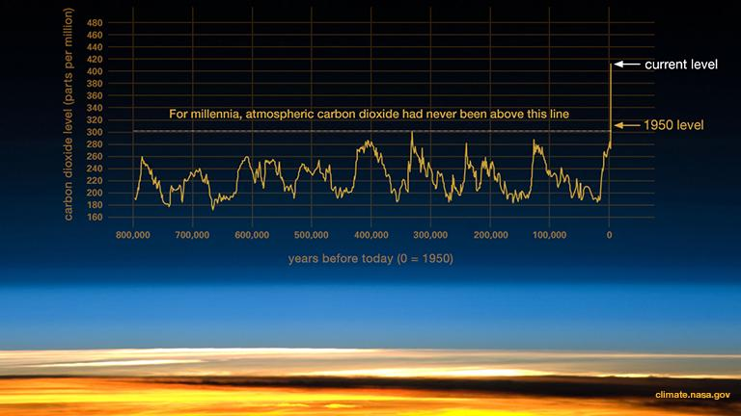
Notes:
My Talking Points:
Here is another look at atmospheric carbon dioxide levels.
Things changed dramatically after 1950.
In 2013, CO2 levels surpassed 400 ppm for the first time in recorded history.
DESCRIPTION: History of CO2 Levels Over Time
First Source: Robust CO2 data from ice cores covering the last 800,000 years. From climate.nasa.gov:
https://climate.nasa.gov/climate_resources/24/graphic-the-relentless-rise-of-carbon-dioxide/
Ancient air bubbles trapped in ice enable us to step back in time and see what Earth's atmosphere, and climate, were like in the distant past. They tell us that levels of carbon dioxide (CO₂) in the atmosphere are higher than they have been at any time in the past 400,000 years. During ice ages, CO₂ levels were around 200 parts per million (ppm), and during the warmer interglacial periods, they hovered around 280 ppm (see fluctuations in the graph). In 2013, CO₂ levels surpassed 400 ppm for the first time in recorded history.
Second Source: From Earth.Org: https://earth.org/data_visualization/a-brief-history-of-co2/
As a point of reference, pre-industrial CO2 levels were around 280 parts per million (ppm) and today, we stand near 420 ppm.
The most distant period in time for which we have estimated CO2 levels is around the Ordovician period, 500 million years ago. At the time, atmospheric CO2 concentration was at a whopping 3000 to 9000 ppm! The average temperature wasn’t much more than 10 degrees C above today’s, and those of you who have heard of the runaway hothouse Earth scenario may wonder why it didn’t happen then. Major factors were that the Sun was cooler, and the planet’s orbital cycles were different.
CO2 Data from Ice Cores.
Robust evidence “only” spans back 800,000 years thanks to ice cores providing high-resolution records in the form of air bubbles trapped under the freezing snow.

Slide 12
Notes:
My Talking Points:
This graph shows even better how fast CO2 levels have risen since 1880.
We averaged 315 ppm of CO2 in our atmosphere in 1960. We reached a high of 424 ppm in May of 2023.
Since the industrial era began around 1750, CO2 concentrations have risen by about 50%.
Twenty of the hottest years on record have occurred since 2000. The Four hottest were in 2016, 2019, 2020, and 2023 was the hottest year yet.
Soil Carbon Sequestration & Storage From Beachapedia:
Atmospheric Carbon and Climate Change
The planet has experienced rapid increases in the concentration of atmospheric carbon, measured at ~315 parts per million (ppm) in 1960, it now reaches over 406 ppm (even up to 412 pending the day) in 2018. This increase in atmospheric carbon is directly correlated to the increase in global average temperature, and is the cause for this temperature anomaly and changing climate.
What is the CO2 level in 2022?
Carbon dioxide measured at NOAA's Mauna Loa Atmospheric Baseline Observatory peaked for 2022 at 421 parts per million in May, pushing the atmosphere further into territory not seen for millions of years, scientists from NOAA and Scripps Institution of Oceanography at the University of California San Diego announced ...Jun 3, 2022
Since the beginning of the industrial era (1750), human activities have raised atmospheric concentrations of CO2 by about 50%. This is more than what had happened naturally over a 20,000 year period (from the Last Glacial Maximum to 1750, from 185 ppm to 278 ppm).
https://climate.nasa.gov/vital-signs/carbon-dioxide/?utm_source=newsletter&utm_medium=email&utm_campaign=monthly+newsletter
Nineteen of the hottest years have occurred since 2000, with the exception of 1998, which was helped by a very strong El Niño. The year 2020 tied with 2016 for the hottest year on record since record-keeping began in 1880 (source: NASA/GISS).
The warmest seven years have all been since 2015, with 2016, 2019 and 2020 constituting the top three. An exceptionally strong El Niño event occurred in 2016, which contributed to record global average warming. Source: https://public.wmo.int/en/media/press-release/2021-one-of-seven-warmest-years-record-wmo-consolidated-data-shows#:~:text=The%20Copernicus%20Climate%20Change%20Service,the%206th%20warmest%20year.
The Copernicus Climate Change Service estimated that 2021 was the 5th warmest year on record but only marginally warmer than 2015 and 2018. NOAA and Berkeley Earth found that 2021 was nominally the 6th warmest year. NASA GISTEMP and HadCRUT have 2021 effectively tied for 6th warmest. Data from the Japanese Meteorological Agency (JMA) Reanalysis rank 2021 as nominally the seventh warmest year.

Slide 13
Notes:
My Talking Points:
Greenhouse gases are measured in units call Global Warming Potential (GWP)
It measures how much heat each type of gas traps compared to Carbon Dioxide.
Methane, Nitrous Oxide and Fluorinated gases trap much more heat than Carbon Dioxide.
However, the other chart shows how much emissions of each type of gas is in our atmosphere.
As you can see, Carbon Dioxide emits 76% of the gas in our atmosphere.
Global Warming Potential (GWP) of GHG. Carbon dioxide =76%.

Slide 14
The global carbon cycle with estimated carbon fluxes. Graphic by World Economic Forum.
Notes:
My Talking Points:
I would like to shift now and talk about the Carbon Cycle. About 200 billion metric tons of carbon move throughout the planet. This includes the atmosphere, biosphere (plants and animals), soil and ocean.
We have knocked the Carbon Cycle out of balance, mostly by burning fossil fuels, but many other things as well such as poor farming practices contribute to the problem.
Nature uses photosynthesis to draw down excess carbon from our atmosphere. The lack of ground cover, deforestation, use of chemical fertilizers, pesticides and herbicides and other practices prevent nature from doing its job.
Our soil can store up to 10 gigatons of Carbon every year if the soil is healthy. Currently we are emitting around 11 gigatons of excess CO2 each year due to poor soil practices.
The Carbon Cycle:
Carbon is a natural, vital part of the Earth’s system. About 200 billion metric tons of carbon move throughout the planet in what is known as the “carbon cycle”, with reserves in the atmosphere, plants and animals (called the biosphere), soil, ocean, and deep geologic reservoirs (like underground oil and gas reserves, also called hydrocarbons). In its natural, balanced cycle, carbon is not only benign but essential to life on earth.
The issue is that humans have put the carbon cycle out of balance, taking roughly 10 billion metric tons of carbon out of geologic reserves by drilling and burning fossil fuels (which would otherwise be in permanent reservoirs) and releasing it back into our atmosphere. This addition of carbon into the atmosphere is surpassing the planet’s natural ability to remove carbon by photosynthesis, resulting in increased concentration of atmospheric carbon, which is amplifying the greenhouse effect and causing climate change.
Approximately 75% of the terrestrial carbon is actually in the soil, and in its healthy state can store up to 11 gigatons of CO2 every year. However, when we lose healthy soils by developing over natural areas, or by conducting conventional agricultural practices like clearcutting, tilling, and over-grazing; we reduce the ability to use this reserve as a natural storage of carbon. We also release the carbon that’s previously been captured back into the atmosphere. Traditional landscaping also reduces and even destroys the soil’s ability to absorb carbon in many of our residential areas, by killing necessary soil biology with chemical fertilizers and pesticides applied to maintain mono-culture turf lawns.
Soil Carbon Sequestration & Storage From Beachapedia.

Slide 15
Notes:
My Talking Points:
Here is a better look at the carbon storage capacity of our world.
The atmosphere holds around 750 billion tons (gigatons) of Carbon. The biosphere holds 550 billion tons. The Soil holds 2300 billion tons of carbon: three times as much as our atmosphere and four times as much as our biosphere.
It is estimated that up to 900 gigatons of excess legacy carbon is currently in our atmosphere. Even if we reach Net-Zero GHG emissions by 2040, we still have all this legacy GHG to draw down to stop global warming effects.
RA practices can help reduce this excess amount dramatically per several scientific sources; up to 80 gigatons or more per year if RA practices are implemented worldwide.
The primary reason is 1 gigaton of carbon sequestered in the soil can draw down 3.67 gigatons of CO2 from our atmosphere through photosynthesis.
Description: Storage capacity of atmosphere, biosphere and pedosphere.
Notes: You can see from this graphic that while planting many more trees would certainly decrease CO2 levels through sequestration, the soil can hold much more CO2.
Source: Kiss the Ground.
It is estimated that up to 900 Gigatons of excess Legacy Carbon Dioxide (CO2) is currently in our atmosphere from burning fossil fuels over the last 200 years. This will still be in our atmosphere even after we reach Net-Zero GHG emissions by 2040. We still need to draw down these emissions to reverse global warming.

Slide 16
What Is Regenerative Agriculture?
Regenerative Agriculture (RA) is a system of farming principles and practices that increases biodiversity, enriches soils, improves watersheds, and enhances the entire ecosystem of the farm.
Using photosynthesis, carbon is captured in the soil by pulling carbon dioxide (CO2) out of the atmosphere to reverse the damages caused by climate change.
RA offers increased yields, resilience to climate instability, improved soil health and many other benefits for farming and ranching communities.
Notes:
My Talking Points:
So, what is Regenerative Agriculture?
Regenerative Agriculture is a system of farming principles and practices that increases biodiversity, enriches soils, improves watersheds, and enhances the entire ecosystem of the farm.
Through photosynthesis, carbon is captured in the soil by pulling CO2 out of the atmosphere to reverse the damages caused by climate change.
It offers increased yields, resilience to climate instability, improved soil health and many other benefits for farming and ranching communities.

Slide 17
What Is Carbon Sequestration?
Carbon sequestration (CS) is the long-term removal or capture of carbon dioxide from the atmosphere to slow down or reverse atmospheric CO2 pollution and to mitigate or reverse global warming.
Examples of carbon sequestration will follow.
Notes:
My Talking Points:
What is Carbon Sequestration?
Carbon sequestration (CS) is the long-term removal or capture of carbon dioxide from the atmosphere to slow down or reverse atmospheric CO2 pollution and to mitigate or reverse global warming.
Examples of carbon sequestration will follow.

Slide 18
Notes:
My Talking Points:
Let’s start with Regenerative Agriculture. It tends to be governed by five basic principles:
Minimal tillage, to prevent erosion and build soil structure.
Keep residue on soil, to absorb moisture and protect the soil.
Maintaining a living root system to absorb nutrients and feed microbes.
Crop diversity, using cover crops and crop rotation to maintain soil health.
Integrating livestock, to fertilize plants and provide nutritional food.
Quote from Zach Laughlin 2020: “The effect of practicing regenerative agriculture is that it restores soil health. For farmers, this means greater yields, the resiliency of the soils to various stresses (droughts and excess moisture), decreased need for outside input costs (fertilizer and pesticides), and increased profits. For consumers, increases in soil health lead to more nutrient dense foods, a pollinator friendly environment, wildlife habitats, erosion control, pollution run-off control, and carbon sequestration through photosynthesis, thus helping to reverse climate change. In short, it helps to solve many of the world’s environmental problems!”
Zach Laughlin:
Ourgoodgrands article 2/13/2020: found at: https://ourgoodbrands.com/what-is-regenerative-agriculture-why-matters/

Slide 19
Photo © Vasilius/Nik Merkulov via Shutterstock. Text from Regeneration International.
Notes:
My Talking Points:
Regenerative Agriculture includes these key agricultural Practices:
This includes things like Crop Rotation, No-or Low Till (plowing), use of Cover Crops, Animal Grazing, Composting, Agroforestry and more.
Through the practices of Regenerative Agriculture, the soil health can be restored, enabling a greater level of carbon sequestration to be achieved with the use of these agricultural practices. Some of these practices will also help to increase the soil’s ability to sequester carbon on pastureland.
More:
ID #6400.B - May be live-streamed, broadcast, and presented in-person, but may not be recorded or modified.
How do you follow those principles? Well, these are the practices that are important: Crop rotation, an old practice that really has value today. No plowing or very low amounts of plowing. No-till or low-till farming practices. Use cover crops. Keep roots in the soil – it stabilizes the soil, helps to maintain the health of the soil, prevents wind and water erosion. Multi-species grazing – the manure becomes fertilizer again, the way it used to be. And if you move them quickly from place to place, they don't make the soil into hard pack soil, they actually improve the quality of the soil; that's what rotational grazing accomplishes. Agroforestry puts some trees back in the pasture area to cool off the animals. Also, their roots help to stabilize and enrich the soil as well. Use organic instead of synthetic inputs, they're much better for the land and more productive and not as costly. Use composting. George Washington Carver, at the beginning of the 20th century, helped to spread the knowledge about composting. Nutrients cycling, make sure that you put the nutrients that are taken out of the soil, back into the soil, partly with diversity of the crops that are planted. And make more use of perennial crops not the annual crops that have to be harvested every year.
DESCRIPTION: Graphic slide detailing the key regenerative agricultural practices of crop rotation, no- or low-till farming practices, the use of cover crops, multi-species grazing, rotational grazing techniques, agroforestry (including silvopasture), organic (not synthetic) inputs, composting, nutrient cycling, and planting perennial crops
ADDITIONAL TALKING POINTS:
Global soil health is in decline.
Soils are a natural carbon sink, storing several times more carbon than the atmosphere.[1*]
But global soil carbon stocks have been declining due to people converting landscapes to croplands and increasing livestock overgrazing land.[1*]
The global agriculture sector faces a dual challenge of increasing food productivity to feed a likely 2050 human population of 10 billion while also closing an estimated 11-gigaton GHG gap between expected emissions that year and those needed to hold global warming below 2 degrees Celsius.[1*]
Regenerative agriculture is a land management practice that prioritizes soil health by rebuilding organic carbon. It can improve carbon sequestration in soil, increase water retention, and reduce erosion.[2*]
Key practices include no- or low-till farming (minimal digging and stirring of soil), the use of cover crops and crop rotation, agroforestry (farmland integrated with trees and shrubs), nutrient recycling, the use of biochar (charcoal-like, thermally decomposed biomass), and managed livestock grazing.[2*]
If cover crops were planted in 25% of global cropland, it could potentially sequester up to about 0.55 gigatons of carbon dioxide per year.[3*] A gigaton is roughly equivalent to 400,000 Olympic pools.[4*]
Applying biochar can not only sequester carbon and improve the condition of some soil types, but also improve food security by improving yields by as much as 25% in the tropics.[3*]
Additionally, farmers using regenerative practices may see greater profits and greater resilience to climate change.[2*]
Continued work and research are needed to address uncertainties about the technical and practical potential of carbon sequestration in soil and vegetation.
Importantly, sequestered carbon must remain in the ground, untouched – and not re-emitted from future land use changes – in order to contribute to climate change mitigation.[1*]
Agricultural solutions must be scalable for significant (large-scale) emissions reductions.[1*]
Growing human populations – and the increasing demand for animal products – continue to put pressure on food productivity and incentivize further land use change.[1*]
Soils are less able to sequester carbon at higher temperatures, so the potential for increasing soil organic carbon will likely decrease as climate change intensifies this century.[3*]
REFERENCES:
[1*] Janet Ranganathan et al., "Regenerative Agriculture: Good for Soil Health, but Limited Potential to Mitigate Climate Change," World Resources Institute, May 12, 2020. https://www.wri.org/blog/2020/05/regenerative-agriculture-climate-change
[2*] Regeneration International, “What is Regenerative Agriculture?,” February 24, 2017. https://regenerationinternational.org/2017/02/24/what-is-regenerative-agriculture/
[3*] (Eds.) Valérie Masson-Delmotte et al., IPCC Special Report on Climate Change, Desertification, Land Degradation, Sustainable Land Management, Food Security, and Greenhouse gas fluxes in Terrestrial Ecosystems, Cambridge University Press, Summary for Policymakers (revised January 2020): 1-41. https://www.ipcc.ch/site/assets/uploads/sites/4/2020/02/SPM_Updated-Jan20.pdf
[4*] Chris Mooney, “To truly grasp what we’re doing to the planet, you need to understand this gigantic measurement,” The Washington Post, July 1, 2015. https://www.washingtonpost.com/news/energy-environment/wp/2015/07/01/meet-the-gigaton-the-huge-unit-that-scientists-use-to-track-planetary-change/
SLIDE SOURCE(S; Carbon Underground text, https://regenerationinternational.org/2017/02/24/what-is-regenerative-agriculture/; https://www.greenamerica.org/blog/me): https://www.wri.org/blog/2020/05/regenerative-agriculture-climate-changethods-regenerative-agriculture-1; https://regenerationinternational.org/2018/05/16/what-is-biochar/

Slide 20
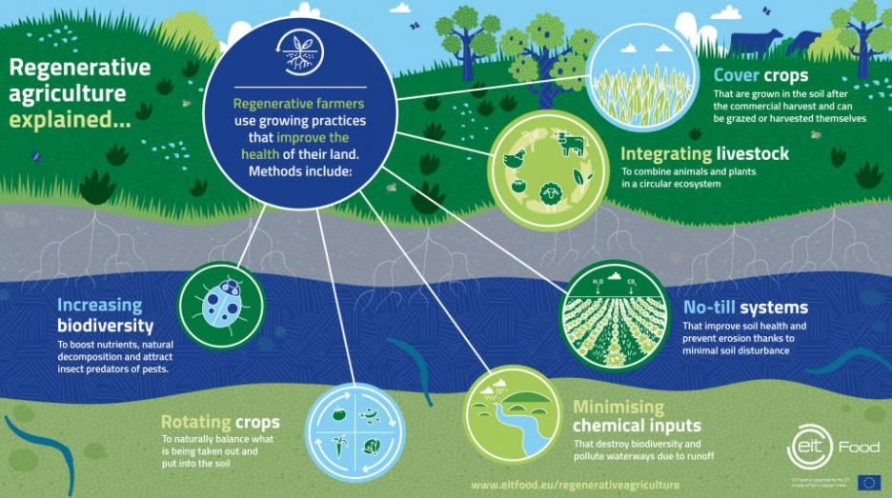
Notes:
My Talking Points:
Here is another look at the types of Regenerative Agriculture practices farmers can use to improve soil health.
Through the use of these methods, soil health can be restored, enabling a greater level of carbon sequestration to be achieved without the use of harmful and costly chemical additives.
I will discuss the increasing biodiversity component in more detail later in this presentation.

Slide 21
Notes:
My Talking Points:
Here is an example of carbon sequestration from growing Cover Crops:
Cover crops are different from growing cash crops sold for profit such as corn or soybeans.
Cover crops are used to improve soil health by protecting from soil erosion and nutrient loss.
Cover crops help control weeds, pests and other diseases and hold more water in the soil.
The right cover crops increase biodiversity and provide nutrients for plant growth without the need for chemical inputs like fertilizers.
Cover crops are different from cash crops, which are those that a farmer sells for profit, such as corn or soybeans.
Cover crops’ primary job is to improve the soil. They get planted in fields that would otherwise be bare—in between growing seasons, for example—to protect the soil from erosion and nutrient loss.
Cover crops also help smother weeds, control pests and diseases, enhance water availability, and increase biodiversity on the farm. Think of cover crops as a living mulch.
Conventional farmers rely on synthetic fertilizers and chemical herbicides to return nutrients to their soils and fight weeds. Those methods have a host of unintended consequences, including water pollution, soil erosion, and loss of essential biodiversity, among others.
Since synthetic inputs aren’t allowed in organic agriculture, organic farmers rely on other methods, including cover cropping, to achieve the same results.
Rodale Institute. https://rodaleinstitute.org/why-organic/organic-farming-practices/cover-crops/

Slide 22
Notes:
My Talking Points:
Here is an example of carbon sequestration from No-Till farming practice:
No-till plowing builds healthy soil that increases the amount of carbon sequestration (CO2) and water absorption (H2O) leading to higher crop yields.
Soil microorganisms thrive in healthy soil which increases nutrient cycling, suppressing plant diseases to grow more nutrient-dense crops.
When soil is plowed, carbon is released into the atmosphere increasing greenhouse gas emissions that warm the planet.
No-till practices also slow evaporation, which not only means better absorption of rainwater, but it also increases irrigation efficiency, ultimately leading to higher yields, especially during hot and dry weather.
Soil microorganisms, fungi and bacteria, critical to soil health, also benefit from no-till practices. When soil is left undisturbed, beneficial soil organisms can establish their communities and feed off of the soil’s organic matter. A healthy soil biome is important for nutrient cycling and suppressing plant diseases. As soil organic matter improves, so does the soil’s internal structure—increasing the soil’s capacity to grow more nutrient-dense crops.
Soil naturally stores carbon. When soil is plowed under, carbon, in the form of organic material such as plant roots and microorganisms, rises to the soil’s surface. This temporarily provides nutrients for crops. But as the soil carbon is exposed to oxygen in the atmosphere, it transforms into carbon dioxide, contributing to the greenhouse gas emissions that warm the planet.
No-till farming minimizes soil disturbance, which helps keep carbon in the soil. It also enriches soil biodiversity, reducing the need for chemical fertilizers that emit greenhouse gases. Studies have shown that organic no-till practices, when combined with cover cropping and organic management, help increase soil organic carbon by up to 9 percent after two years and 21 percent after six years.
Regeneration International. https://regenerationinternational.org/2018/06/24/no-till-farming/

Slide 23
Notes:
My Talking Points:
This slide shows the type of tillage methods used by 75% of U.S. farmers in 2017:
No-till (no plowing) was used on 37% of U.S. cropland
Low-till (reduced plowing) was used on 35% of U.S. cropland.
Conventional plowing was used on 28% of U.S. cropland.
We need a higher percentage of farmers to practice No or Low-tilling methods to reach Net-Zero GHG emissions by the year 2050 to mitigate climate change effects.
Data from the 2017 Census of Agriculture shows 37% of tillable acreage in the U.S. is no-tilled, up 2.4 percentage points from the 2012 Census, and 35% is in reduced tillage, up 7 points from 2012. Intensive tillage (28%) fell a whopping 10 points from 5 years ago. Jul 10, 2019

Slide 24
Notes:
My Talking Points:
No-Till percentages are growing in the U.S. Companies such as Cargill are promoting adoption.
Cargill plans to advance RA practices among row crops.
They plan to implement RA on 10 million acres of farmland and ranchlands in North America by 2030.
General Mills plans to advance RA practices on 1 million acres of farmland by 2030.
Other food producers are planning similar programs.
It is estimated that global food system accounts for about 33% of GHG emissions and 70% of water consumption.
As a start, we are working with farmers to advance regenerative agriculture practices across 10 million acres of North American row crop farmland by 2030. In addition to this goal focused on crops, we are exploring ways ranchers can adopt sustainable grazing practices to harness the potential of their cattle to restore and protect natural ecosystems, like prairies. And we’re making sure it’s all done in a way that offers long-term sustainability benefits to local communities.
Cargill. https://www.cargill.com/sustainability/regenerative-agriculture
MINNEAPOLIS, Minnesota - General Mills announced its commitment to advance regenerative agriculture practices on one million acres of farmland by 2030. The company will partner with organic and conventional farmers, suppliers and trusted farm advisors in key growing regions to drive the adoption of regenerative agriculture practices. A contributor to climate change, it is estimated that the global food system accounts for roughly one-third of greenhouse gas (GHG) emissions and 70 percent of water consumption.
General Mills. https://www.generalmills.com/en/News/NewsReleases/Library/2019/March/Regen-Ag
Slide data from USDA Report: Tillage Intensity and Conservation Cropping in the United States:
https://www.ers.usda.gov/webdocs/publications/90201/eib-197.pdf?v=1783.8

Slide 25
Notes:
My Talking Points:
Here is another chart showing similar results we have discussed.
Growth in Low-Till and No-Till farming is growing steadily, especially in the Coastal Regions.
As mentioned earlier, around 37% of tillable acreage in the U.S. is No-Tilled and 35% is reduced Tillage.
Conservation tillage is growing in the U.S. with the highest percentages along the coastal regions.
Data from the 2017 Census of Agriculture shows 37% of tillable acreage in the U.S. is no-tilled, up 2.4 percentage points from the 2012 Census, and 35% is in reduced tillage, up 7 points from 2012. Intensive tillage (28%) fell a whopping 10 points from 5 years ago. Jul 10, 2019

Slide 26
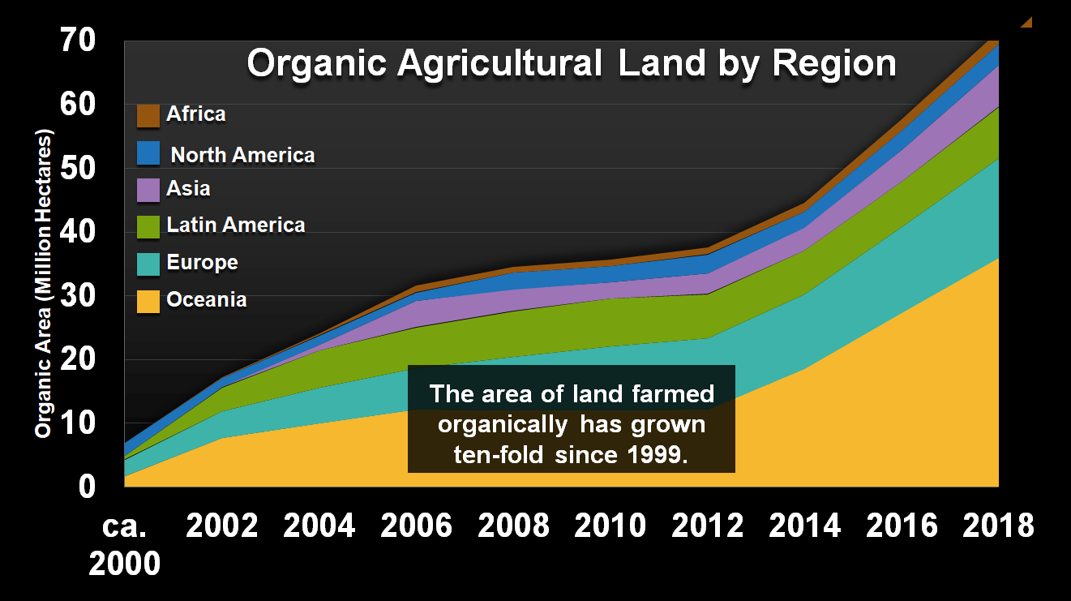
Chart Created Using Data Provided By Various Global World Studies Listed In Notes Below.
Notes:
My Talking Points:
This chart shows the amount of land farmed organically in the world by region.
It has grown ten-fold since 1999. The farming culture is starting to change for the better.
ID #5534.D - Can be used in noncommercial online and TV broadcasts of your presentation, but not modified.
This is part of a global movement toward organic agriculture. Australia's probably done the best job, but this is a hopeful trend, and we are seeing now a farmer-led movement to try to use better methods.
(Oceania is a geographic region that includes Australasia, Melanesia, Micronesia and Polynesia. Spanning the Eastern and Western Hemispheres.)
DESCRIPTION: Graph showing the growth of organic agricultural land by region from 2000 to 2018 in millions of hectares with text stating that the area of land farmed organically has grown ten-fold since 1999
ADDITIONAL TALKING POINTS: The global food system is incredibly complex and shaped by many interrelated factors affected by climate change.[1*]
Climate change is already affecting the crops we rely on.[1*]
Rising temperatures are helping create more drought, heat stress, and flooding while enabling pests and diseases to spread further and faster than ever before – all with profound consequences for the crops we rely on.[1*]
Crops have responded to these challenges in increasingly disastrous ways that often diminish the nutrition they carry and increase the toxins they accumulate. The result: our food is becoming less nutritious.[2*]
Food challenges don’t end there, due to the fact that the planet is now experiencing more numerous and extreme hot days than at any other time in human history.
If the level of warming exceeds a crop's optimum temperature for extended periods, yields can decline.[2*]
More extreme temperatures over longer periods lead to droughts and hinder important chemical processes in the digestive systems of ruminants, like cows or sheep, which can cause asphyxiation.[2*]
Warmer temperatures also contribute to the poleward migration of many pests and the spread of harmful mold.
Beyond expanding the range of pests, warmer temperatures also increase the reproductive functions of insect herbivores, making these pests an even greater threat.[3*]
Giant swarms of desert locusts threaten famines in Africa, the Middle East, and West and South Asia. Climate impacts including heat waves and intense rains from tropical storms can lead to more prolific and unpredictable locust swarming.[4*]
Aflatoxins are molds that can affect plant crops and raise the risk of liver damage, cancer, and blindness. Shifting weather patterns are spreading these molds to more areas and exposing approximately 4.5 billion people in developing countries each year to this danger, though the amounts are largely unmonitored, and the numbers are rising.[6*]
Rising carbon dioxide levels do more than trap heat in the atmosphere – they also have a direct impact on crop nutrition.
Researchers found that major staple crops – like wheat, barley, rice, and potato – grown in projected carbon dioxide levels for the year 2100 have 6–15 percent less protein than those grown in current carbon dioxide levels, significantly reducing their nutritional value.[7*]
High carbon dioxide concentrations cut levels of key nutrients such as iron, zinc, calcium, and magnesium by 5–10 percent in most plant species.[7*]
About two billion people suffer from dietary deficiencies of zinc and iron already, with most depending on grains and legumes as their main source of these important nutrients.[8*]
The number of people expected to suffer from zinc deficiency is predicted to increase by 138 million by 2050. This increase will disproportionately affect people living in Africa and South Asia, affecting 48 million in India alone.[8*]
Climate change also has serious consequences for seafood, as warm water temperatures reduce the nutritional quality of fish and squid.
Fish and squid have a significantly lower ratio of healthy oils to protein during warm water events (when sea surface temperatures go higher than the 10-year mean).
Nutritional changes in these food sources have a ripple effect throughout the marine environment, affecting marine predators and fisheries capturing food for human consumption.[9*]
Climate change will have a disproportionate impact on countries already facing food insecurity.
Countries experiencing the worst impacts from rising temperatures are typically the most food insecure, having lower food supply in terms of calories and crop yields.
Some of the countries that will be particularly impacted are India, Brazil, Indonesia, and Venezuela. Other countries – like those in sub-Saharan Africa that have not benefitted from many agricultural advancements – will also be powerfully affected by these changes.[10*]
REFERENCES:
[1*] M. E. Brown, et al., “Executive Summary: Climate Change, Global Food Security, and the U.S. Food System” (U.S. Department of Agriculture, University Corporation for Atmospheric Research, National Center for Atmospheric Research, December 2015). https://www.usda.gov/sites/default/files/documents/CCFS_Executive_Summary.pdf
[2*] Daniel Francis, “Crops react to climate change by accumulating toxins,” Pulse Headlines, June 1, 2016. http://www.pulseheadlines.com/crops-react-climate-change-accumulating-toxins/33496/
[3*] D. P. Bebber, M. A. T. Ramotowski, and S. J. Gurr, "Crop pests and pathogens move polewards in a warming world," Nature Climate Change, vol. 3 (September 2013): 985-988. https://www.researchgate.net/publication/257110122_Crop_pests_and_pathogens_move_poleward_in_a_warming_world
[4*] Bob Berwyn, "Locust Swarms, Some 3 Times the Size of New York City, Are Eating Their Way Across Two Continents," Inside Climate News, March 22, 2020. https://insideclimatenews.org/news/20032020/locust-swarms-climate-change
[5*] R. P. Singh, et al., “The Emergence of Ug99 Races of the Stem Rust Fungus is a Threat to World Wheat Production,” Annual Review of Phytopathology 49 (September 2011): 465-481. https://www.ars.usda.gov/ARSUserFiles/34883/Singh-AnnRePhytopath.pdf
[6*] Kagondu Njagi, “Extreme weather increasing level of toxins in food, scientists warn,” Reuters, May 31, 2016. http://www.reuters.com/article/us-climatechange-food-toxins-idUSKCN0YM0AH
[7*] Lewis Ziska, et al., “Climate and Health Assessment Chapter 7: Food Safety, Nutrition, and Distribution,” (US Global Change Research Program, 2016). https://health2016.globalchange.gov/food-safety-nutrition-and-distribution
[8*] Cheikh Mbow et al., “Special Report on Climate Change and Land, Chapter 5: Food Security,” Intergovernmental Panel on Climate Change (2019): 437-550. https://www.ipcc.ch/srccl/chapter/chapter-5/
[9*] University of Sydney, “Nutritional quality of fish and squid reduced by warm water events: Consumption by humans and marine animals impacted,” ScienceDaily, June 8, 2018. https://www.sciencedaily.com/releases/2018/06/180608093654.htm
[10*] Paolo Agnolucci et al., “Impacts of rising temperatures and farm management practices on global yields of 18 crops,” Nature Food 1, (September 15, 2020): 562-571. https://www.nature.com/articles/s43016-020-00148-x
SLIDE SOURCE(S): http://orgprints.org/1000/1/willer-yussefi-2000-01-world-of-organic.pdf; http://orgprints.org/13882/1/willer-yussefi-2002-world-of-organic.pdf; http://orgprints.org/2555/1/willer-yussefi-2004-world-of-organic.pdf; http://orgprints.org/5161/2/willer-yussefi-2005-world-of-organic.pdf; https://www.organic-world.net/fileadmin/documents/yearbook/2019/FiBL-2019-Global-data-2017.pdf; https://www.organic-world.net/fileadmin/documents/yearbook/2019/FiBL-2020-Global-data-2018.pdf

Slide 27
Notes:
My Talking Points:
This chart actually shows how fast RA practices are growing worldwide.
RA practices have increased 15% per year on average since 2008, or 93% over last 10 years.
This equals around 14.7% of total global cropland per a recent Food & Agriculture study.
This is very good, but it must change even faster to stop climate change and reverse global warming by 2050.
Global adoption of conservation agriculture practices is growing. From 2008 to 2015, the amount of global cropland farmed using conservation practices increased 15% per year, on average.
By Michaela Paukner posted on October 25, 2021 | Posted in No-Till Farming 101, Soil Health
A recent study finds 507.6 million no-till acres exist worldwide, a massive increase since 2008-09.
The number of no-till acres worldwide has increased by 93% in 10 years, bringing the total number to 507.6 million acres.
Amir Kassam, a professor at the University of Reading in England; Theodor Friedrich, a retired researcher with the Food and Agriculture Organization of the United Nations; and Rolf Derpsch, a long-time no-till researcher based in South America, recently authored a paper examining the adoption of no-till worldwide over the 10-year period of 2008-09 through 2018-19.
Cropland using conservation agriculture, the term used for no-tillage outside of North America, makes up about 14.7% of the total global cropland, according to the study. Adoption is growing by about 25 million acres per year, and Derpsch believes all farmland needs to be conservation cropland in order for society to continue to exist.
Link: https://www.no-tillfarmer.com/articles/10906-worldwide-no-till-acres-increase-93-in-10-years#:~:text=Cropland%20using%20conservation%20agriculture%2C%20the,cropland%2C%20according%20to%20the%20study.

Slide 28
Can We Really Reverse Climate Change With Regenerative Agriculture?
The answer is Yes!
We can reverse Climate Change and stop global warming using Nature’s own solutions for pulling CO2 out of our atmosphere.
The solutions can be implemented today!
We don’t have to wait for technological solutions.
We can use Nature’s own solutions!
I will show you how this is done in the following slides.
Notes:
My Talking Points:
Can we really reverse climate change with Regenerative Agriculture?
The answer is Yes!
We can reverse Climate Change and stop global warming using Nature’s own solutions for pulling CO2 out of our atmosphere.
The solutions can be implemented today!
We don’t have to wait for technological solutions that are costly, mostly unproven and potentially harmful to our environment.
We can use Nature’s own solutions!
I will show you how this is done in the following slides.

Slide 29
How Can We Do This?
By using soil as a Carbon Sink to pull down carbon (CO2) from our atmosphere naturally.
This is called Carbon Sequestration.
This is a natural process that can restore balance and stop global warming.
It is possible to pull down more carbon than we emit each year with the right land management practices.
So, how does Carbon Sequestration work?
Notes:
My Talking Points:
How can we do this?
By using soil as a Carbon Sink to pull down carbon dioxide (CO2) from our atmosphere naturally.
This is called Carbon Sequestration.
This is a natural process that can restore balance and stop global warming.
It is possible to pull down more carbon than we emit each year with the right land management practices.
So, how does Carbon Sequestration work?

Slide 30
Source: UNC ANR Solution Center for Nutrient Management
Notes:
My Talking Points:
Plants draws down carbon dioxide CO2 through photosynthesis and pass the carbon/sugar molecules through its root systems. Soil carbon comes from organic matter decomposition, which if not covered is released back into our atmosphere.
Soils store up to three times more carbon than exists in the atmosphere. Plants absorb atmospheric carbon dioxide during photosynthesis returning plant residues into the soil contributing to soil carbon. Much of this carbon ultimately returns to the atmosphere as soil microbes decompose releasing carbon dioxide. Soil carbon stores can increase if the rate of carbon inputs exceeds the rate of microbial decomposition.
Carbon sequestration refers to this process of storing carbon in soil organic matter and thus removing carbon dioxide from the atmosphere.
UNC ANR Solution Center for Nutrient Management, Published on: September 30, 2016.
Sequestering Carbon in the Soil Using Biochar:
Biochar is produced from burning organic material at high temperatures with little to no oxygen availability. The potential of utilizing biochar to sequester carbon in the soil has received considerable research attention in recent years as part of efforts to develop climate smart agricultural practices. As the majority of biochar is carbon (70-80%) it can potentially contribute more carbon than plant residue (approximately 40% carbon) of similar mass. Furthermore, around 60% of this biochar organic carbon is of high stability and therefore resists decomposition more-so than plant material that has not be processed into biochar. That being said, many questions remain as to the effectiveness of biochar application in sequestering carbon.

Slide 31
Living Root Systems Are Key
Source: Moises Velasquez-Manoff for Genetic Literacy Project
Notes:
My Talking Points:
Maintaining living root systems are key to Regenerative Agriculture practices.
Roots store Carbon and feed the microorganisms that in turn provide nutrients for plants.
Together, they build healthy soil needed to regenerate the land and help mitigate global warming.
How this works is explained in the next slide. It’s called the Nutrient Cycle.
[Regenerative agriculture’s] guiding principle is not just to farm sustainably — that implies mere maintenance of what might, after all, be a degraded status quo — but to farm in such a way as to improve the land. The movement emphasizes soil health and, specifically, the buildup of soil carbon. This happy coincidence is one reason that carbon-farming advocates repeatedly describe their project as a “win-win.” Society could theoretically remove carbon from the atmosphere and store it in the earth, and at the same time enhance the fortunes of farmers and the overall stability of the nation’s food supply.
Critics of regenerative agriculture say that it can’t be adopted broadly and intensively enough to matter — or that if it can, the prices of commodities might be affected unfavorably. Mark Bradford, a professor of soils and ecosystem ecology at Yale, questions what he sees as a quasi-religious belief in the benefits of soil carbon. The recommendation makes sense intuitively, he told me. But the extent to which carbon increases crop yield hasn’t been quantified, making it somewhat “faith-based.”
Moises Velasquez-Manoff for Genetic Literacy Project.
Regenerative agriculture: Can ‘carbon farming’ help battle climate change by improving soil health?
Moises Velasquez-Manoff | New York Times | April 20, 2018

Slide 32
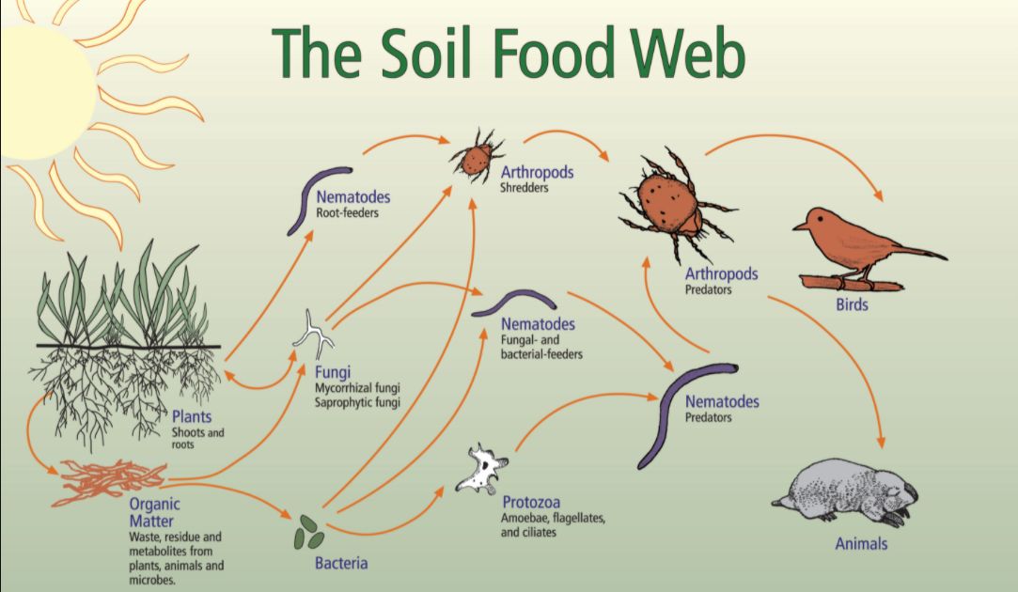
Sequestration of Carbon: Regenerative Agriculture – Nutrient Cycle
Dr. Elaine Ingham, Soil Food Web, University of Illinois Ag Extension
Notes:
My Talking Points:
This is the Nutrient Cycle as defined by Doctor Elaine Ingham’s Soil Food Web:
Nature uses plant root systems to grow and feed microorganisms in healthy soil called Soil Organic Matter (SOM).
This biology is what creates healthy soil to grow plants.
There are three principles that need to be understood.
One, nature exists as a series of relationships with each organism playing a role as shown in this slide.
Two, Nutrient Cycling is Key. Organisms consume what they need to live and grow and changes nutrients into food sources beneficial for other organisms.
Three, Diversity is Key. Different organisms cycle nutrients for each predator or prey. The whole system is needed to maintain the soil food web.
The nice thing about natural systems is that they naturally try to repair and rebuild. If left alone, they will do just that. It is the management of people (often well-meaning ones) that prevents this process from happening. In order to help this process along, there are three principles of natural systems that need to be understood:
1) Nature exists as a series of relationships, not as a series of individuals. Each individual organism has a role to play. When every role is filled, balance is maintained and the whole system benefits.
2) Nutrient cycling is key. As one organism consumes what it needs to live and grow, it takes nutrients from the environment and changes them in a way that is beneficial to its needs. When that organism (or its waste) becomes a food source for another organism, those nutrients are cycled to the next stage. The nutrients must keep cycling and recycling through the system.
3) Diversity is key. Different organisms have different methods of cycling nutrients and different predator/prey relationships. The system functions best as a whole when there are as many of those relationships present as possible.
Savory Institute. https://savory.global/regenerative-agriculture-enhance-biodiversity-farming-methods-grazing/

Slide 33
Notes:
My Talking Points:
Healthy soil is approximately 45% minerals, 25% water, 25% air and 5% organic matter.
Microorganisms require air and water to survive and grow to feed plants and build healthy soil.
Plowing destroys the structure needed for microorganisms and results in compacted dirt that cannot absorb water or prevent soil erosion and pollution runoff.
Building healthy soil is the key to regenerative agriculture practices.
So, let’s talk about what healthy soil looks like and how we can regenerate that soil. You might be surprised to see that 25% of healthy soil is composed of air. The air plays a significant role in enabling healthy soil to absorb and hold water to withstand floods and droughts. Compacted soil, as that subjected to tilling, will not have much air in its composition.

Slide 34
Loss Of Top Soil
Loss Of Top Soil
The Midwest Corn Belt Farmland Has Lost A Third Of Its Carbon-Rich Topsoil Through Erosion.
Generating Three Centimeters Of Topsoil Takes 1,000 Years.
Only 60 Years of Farming Left If Soil Degradation Continues Per A UN Official.
About A Third Of The World’s Soil Has Already Been Degraded Per The Food
And Agriculture Organization (FAO).
A hilltop completely denuded of A-horizon soil in a field near Guthrie Center, IA. Photo credit: Evan Thaler
A hilltop completely denuded of A-horizon soil in a field near Guthrie Center, IA. Photo credit: Evan Thaler
Notes:
My Talking Points:
Now that we know how Carbon is stored on our planet, we can turn our attention to the condition of our topsoil and how farmers can benefit from implementing RA practices. First here are some facts:
The Midwest Corn Belt Farmland Has Lost A Third Of Its Carbon-Rich Topsoil Through Erosion.
Generating Three Centimeters Of Topsoil Takes Nature up to 1,000 Years.
Only 60 Years of Farming Left If Soil Degradation Continues Per A UN Official.
About A Third Of The World’s Soil Has Already Been Degraded Per The Food And Agriculture Organization (FAO).
University of Massachusetts, AMHERST, Mass. February 15, 2021 – More than one-third of the Corn Belt in the Midwest – nearly 30 million acres – has completely lost its carbon-rich topsoil, according to University of Massachusetts Amherst research that indicates the U.S. Department of Agriculture has significantly underestimated the true magnitude of farmland erosion. https://www.umass.edu/news/article/corn-belt-farmland-has-lost-third-its
Only 60 Years of Farming Left If Soil Degradation Continues
ROME (Thomson Reuters Foundation) - Generating three centimeters of top soil takes 1,000 years, and if current rates of degradation continue all of the world's top soil could be gone within 60 years, a senior UN official said on Friday.
About a third of the world's soil has already been degraded, Maria-Helena Semedo of the Food and Agriculture Organization (FAO) told a forum marking World Soil Day.
December 5, 2014
BBC in association with Corteva Agriculture: In Iowa they call it “black gold” – a fertile blanket covering the landlocked Midwestern state. Thousands of years of prairie grass growth, death and decomposition have left a thick layer of dark, organic matter on the vast plains.
When European-American settlers first began ploughing in Iowa, they found the weather and local geology had combined this organic mulch with sand and silt to form a nutrient-rich type of soil called loam. It gave Iowa one of the most fertile soils on the planet and enabled it to become one of the largest producers of corn, soybeans and oats in the United States over the last 160 or so years.
But beneath the feet of Iowa’s farmers, a crisis is unfolding. The average topsoil depth in Iowa decreased from around 14-18 inches (35-45cm) at the start of the 20th Century to 6-8 inches (15-20cm) by its end. Relentless tilling and disturbance from farm vehicles have allowed wind and water to whisk away this priceless resource.
The same picture is seen on farms worldwide. Soils are becoming severely degraded due to a combination of intensive farming practices and natural processes. As the layer of fertile topsoil thins, it gets increasingly difficult to grow crops for food. Without altering agricultural practices and urgently finding ways to preserve soil, the global food supply starts to look precarious.

Slide 35
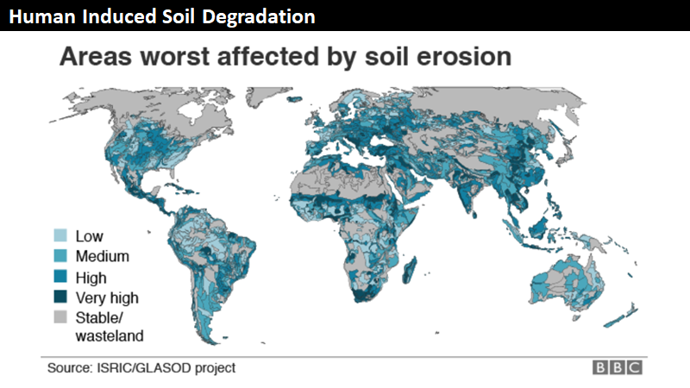
Notes:
My Talking Points:
This slide shows the extent of soil degradation in the world. 3.2 billion people are suffering now.
Agriculture needs to close the 11 gigaton gap between carbon emissions and CO2 draw down to keep global warming below 2 degrees Celsius.
Regenerative agriculture practices can easily achieve this goal if healthy soil farming practices are implemented by all farmers and ranchers.
DESCRIPTION: Global Map of Human Induced Soil Degradation.
NOTES: Article Quote: About 3.2 billion people worldwide are suffering from degraded soils, said IPBES chairman Prof Sir Bob Watson.
"That's almost half of the world population. There’s no question we are degrading soils all over the world. We are losing from the soil the organic carbon and this undermines agricultural productivity and contributes to climate change. We absolutely have to restore the degraded soil we’ve got."
SOURCE: Climate change being fuelled by soil damage – report. By Roger Harrabin, BBC environment analyst. Published29 April 2019.
IPBES – the Intergovernmental Science-Policy Platform on Biodiversity and Ecosystem Services - a panel studying the benefits of nature to humans.
IPBES chairman Prof Sir Bob Watson previously led the IPCC.
ADDITIONAL TALKING POINTS:
Global soil health is in decline.
•Soils are a natural carbon sink, storing several times more carbon than the atmosphere.[1*]
•But global soil carbon stocks have been declining due to the conversion of landscapes to croplands and overgrazing from increasing livestock.[1*]
•The global agriculture sector needs to close an estimated 11-gigaton GHG gap between expected emissions in 2050 and those needed to hold global warming below 2 degrees Celsius, while increasing food productivity to feed a likely population of 10 billion.[1*]
Regenerative agriculture is a land management practice that prioritizes soil health by rebuilding organic carbon and can improve carbon sequestration of soil and increase its water retention and reduce erosion.[2*]
•Key practices include no- or low-till farming, the use of cover crops and crop rotation, agroforestry (farmland integrated with trees and shrubs), nutrient recycling, the use of biochar (charcoal-like, thermally decomposed biomass), and managed livestock grazing.[2*]
•According to one study, the use of cover crops on 85 percent of annually planted US cropland could sequester around 100 million tons of carbon dioxide per year, offsetting about 18 percent of US agricultural production emissions and 1.5 percent of total US emissions.[1*]
•The sequestration potential of cover crops would be up to about 0.55 gigatons of carbon dioxide per year if applied to 25 percent of global cropland.[3*] A gigaton is roughly equivalent to 400,000 Olympic pools.[4*]
•The application of biochar can sequester carbon and improve the condition of some soil types, and improve food security by improving yields by as much as 25 percent in the tropics.[3*]
•Additionally, farmers using regenerative practices may see greater profits and greater resilience to climate change.[2*]
Continued work and research are needed to address uncertainties about the technical and practical potential of carbon sequestration in soil and vegetation.
•Importantly, sequestered carbon must remain in the ground, untouched – and not re-emitted from future land use changes – in order to contribute to climate change mitigation.[1*]
•Agricultural solutions must be scalable for significant (large-scale) emissions reductions.[1*]
•Growing human populations, and the increasing demand for animal products, continue to put pressure on food productivity and incentivize further land use change.[1*]
•Soils have reduced capacity to sequester carbon at higher temperatures, so the potential for increasing soil organic carbon will likely decrease as climate change intensifies this century.[3*]
REFERENCES:
[1*] Janet Ranganathan et al., "Regenerative Agriculture: Good for Soil Health, but Limited Potential to Mitigate Climate Change," World Resources Institute, May 12, 2020. https://www.wri.org/blog/2020/05/regenerative-agriculture-climate-change
[2*] Regeneration International, “What is Regenerative Agriculture?,” February 24, 2017. https://regenerationinternational.org/2017/02/24/what-is-regenerative-agriculture/
[3*] (Eds.) Valérie Masson-Delmotte et al. , IPCC Special Report on Climate Change, Desertification, Land Degradation, Sustainable Land Management, Food Security, and Greenhouse gas fluxes in Terrestrial Ecosystems, Cambridge University Press, Summary for Policymakers (revised January 2020): 1-41. https://www.ipcc.ch/site/assets/uploads/sites/4/2020/02/SPM_Updated-Jan20.pdf
[4*] Chris Mooney, “To truly grasp what we’re doing to the planet, you need to understand this gigantic measurement,” The Washington Post, July 1, 2015. https://www.washingtonpost.com/news/energy-environment/wp/2015/07/01/meet-the-gigaton-the-huge-unit-that-scientists-use-to-track-planetary-change/

Slide 36
Graphic Produced by General Mills 2018
Notes:
My Talking Points:
This slide shows what Regenerative Agriculture does: It Shifts The Paradigm.
Instead of competing with nature, we partner with nature.
We stop using conventional industrial or factory farming methods that rely on monoculture crops, synthetic fertilizers and deforestation to feed animals.
All of this is causing desertification of our topsoil at a rate that will result in the loss of two-thirds of our landmass to deserts by 2100.
We need to cover the soil when not in use.
© 2020 The Green Directory | All Rights Reserved
Factory farming, big-agri, monocultures – our current farming methods are responsible for loss of topsoil, deforestation and the extinction of wild plants & animals throughout the world. If desertification continues at this rate, two thirds of the planet’s landmass will be desert by 2100. That’s most of Africa, Australia, Central Asia & the Western US.
Desertification through inappropriate land management, exacerbated by climate change is one of the biggest threats facing humanity. From Africa to India, China, Australia, and the Southern USA, deserts are growing at alarming rates – about 120,000 square kilometers annually. According to the United Nations, desertification is potentially the most threatening ecosystem change impacting livelihoods of the poor.

Slide 37
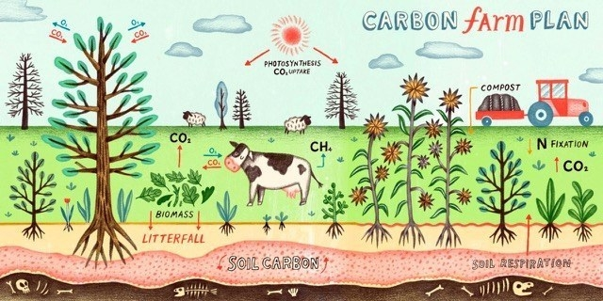
Benefits of RA: Decrease Greenhouse Gas (GHG) Emissions
Image: Landsmart
Notes:
My Talking Points:
Now we can turn to the Benefits of Regenerative Agriculture: not only to farmers and ranchers, but for the world.
Benefit #1: RA Can Decrease Greenhouse Gas Emissions.
RA is a key solution to combating climate change. Agriculture alone is directly responsible for about 10% of GHG emissions. Together with all land and food production RA accounts for around 25% of GHG.
We currently release 43 to 50 gigatons of CO2 into our atmosphere each year.
Studies have shown that Implementing RA practices can pull down or sequester up to 37.7 or more tons of CO2 per hectare per year (= 15.3 tons per acre per year).
If only 5-10% of worldwide farmers practice RA, we can sequester more than 100% (45.12 Gt vs 43 Gt) of the carbon we release into our atmosphere each year.
If 100% of farmers practiced RA, we can effectively sequester more than 80 gigatons of carbon per year.
Regenerative Agriculture is a key solution to climate change. Together with forestry and other land use, agriculture is responsible for just under 25 percent of all human-created GHG emissions. Climate Reality
With the use of cover crops, compost, crop rotation and reduced tillage, we can actually sequester more carbon than is currently emitted, tipping the needle past 100% to reverse climate change...Rodale Institute
Importantly, regenerative agricultural practices also help us fight the climate crisis by pulling carbon from the atmosphere and sequestering it in the ground. In fact, studies have indicated that we can sequester approximately 38,000 tons of carbon per hectare and if only 10% of the world’s farms introduced regenerative agricultural practices, we could sequester more than the 50% of sequestration needed to draw down the CO2 currently being released into the atmospheres and oceans. (Regeneration International).
Scaling up a small percentage (5-10%) of best practice regenerative and organic systems will result in billions of tons (Gt) of CO2 per year being sequestered into the soil and into continuous, perennial above ground biomass. The identification, funding, and deployment of these best practices on 5-10% or more of the world’s total croplands (4 billion acres), rangelands (8 billion acres), and forestlands (10 billion acres) will be more than enough to draw down and cancel out all the current CO2 and greenhouse gases (43 Gt of CO2) that are currently being emitted, without putting any more CO2 into the atmosphere or the oceans.
Currently when carbon dioxide CO2 is released into the atmosphere from the burning of fossil fuels or destructive agriculture or land use practices (currently 43 Gt of CO2 emissions per year), approximately 50% of these 43 Gt of CO2 emissions remain in the atmosphere (21.5 Gt of CO2 annually), while 25% is absorbed by land, plants, and trees (10.75 Gt CO2), and the remainder 25% (10.75 Gt CO2) is absorbed into the ocean. T
BEAM (Biologically Enhanced Agricultural Management), developed by Dr. David Johnson of New Mexico State University, produces organic compost with a high diversity of soil microorganisms, especially fungal material. Multiple crops grown with BEAM have achieved very high levels of sequestration and yields. Research published by Dr. Johnson and colleagues show: “… a 4.5-year agricultural field study promoted annual average capture and storage of 10.27 metric tons’ soil C ha-1 year -1 while increasing soil macro-, meso- and micro-nutrient availability offering a robust, cost effective carbon sequestration mechanism within a more productive and long-term sustainable agriculture management approach.” These results are currently being replicated in other trials.
These figures mean that BEAM can sequester 37,700 kilos (37.7 tons) of CO₂ per hectare per year which is approximately 15.3 tons of CO₂ per acre.
The deployment of all of these regenerative and organic best practices across the world on 5-10% of all agricultural lands (including arid and semi-arid lands where raising crops and grazing animals are increasingly problematic) would result in 45.12 Gt of CO2 per year being sequestered into the soil, and stored aboveground on a continuous basis, which is 50% more than the amount of sequestration needed to drawdown the 31.25 Gt of CO2 that is currently being released into the atmosphere and the oceans. And this does not include the massive CO2 sequestration that is possible under the Trillion Tree Campaign.
https://regenerationinternational.org/2021/03/08/best-practices-how-regenerative-organic-agriculture-and-land-use-can-reverse-global-warming/
Soil Food Web studies show up to 80 Gigatons of carbon can be sequestered per year if all farmers and ranchers worldwide practice RA methods.

Slide 38
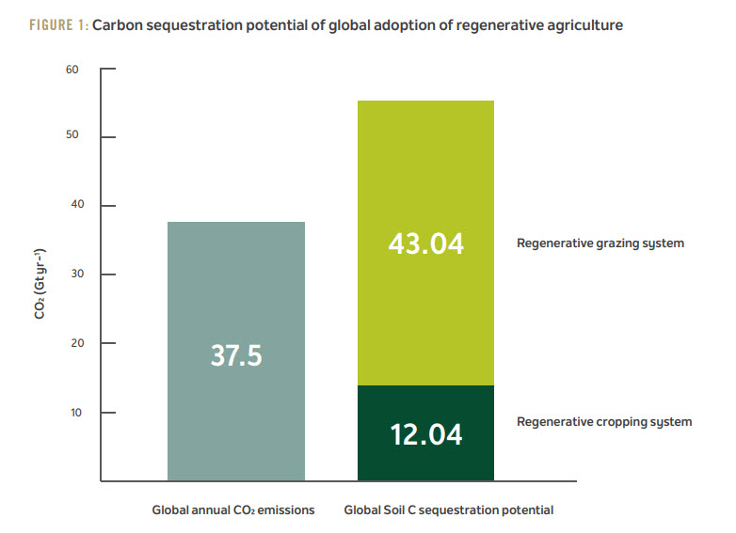
Benefits of RA: Potential To Reverse Climate Change
Image: Rodale Institute White Paper 2020.
Notes:
My Talking Points:
Benefit # 2: RA Has The Potential To Reverse Climate Change.
If we can decrease the amount of GHG gases in our atmosphere each year we can potentally reverse climate change.
This is another study from the Rodale Institute on the effectiveness of RA practices.
The vast majority of GHG emissions come from Carbon Dioxide (CO2); around 38 out of 55 gigatons per year.
Regenerative Grazing Systems and Cropping Systems alone can draw down 55 gigatons of CO2 each year if practiced globally.
Description: Benefits of RA: Potential To Reverse Climate Change.
In 2018, global emissions of greenhouse gases were 55.3 metric gigatons (Gt CO2e). The vast majority of these emissions—37.5 Gt—come from carbon dioxide, which could be reduced significantly by regenerative agriculture [4]. Data from farming and grazing studies show the power of exemplary regenerative systems that, if achieved globally, would drawdown more than 100% of current annual CO2 emissions. Global extrapolations of carbon sequestration rates recorded by agricultural scientists in Table 1 are provided as a thought experiment showing the power of regenerative agriculture to drawdown atmospheric carbon dioxide.
If only cover crops were adopted in otherwise conventional systems across all cropland [16] ~4% of annual CO2 emissions might be sequestered. However, by bundling practices, if management of all current cropland shifted to a regenerative system like the MidAtlantic site [18] we could potentially sequester 8 times more than cover crops alone, or 32% of annual CO2 emissions (~12 Gt CO2). And, if all global pasture was managed to a regenerative model like the Midwestern US study [23], an additional 114% of all annual CO2 emissions (~43 Gt CO2) might be sequestered.
By those calculations, shifting both crop and pasture management globally to regenerative systems is a powerful combination that could drawdown more than 100% of annual CO2 emissions (Figure 1), pulling carbon from the atmosphere and storing it in the soil.
Rodale Institute, Regenerative Organic Agriculture and the Soil Carbon Solution, September 2020.
https://rodaleinstitute.org/wp-content/uploads/Rodale-Soil-Carbon-White-Paper_v8.pdf.

Slide 39
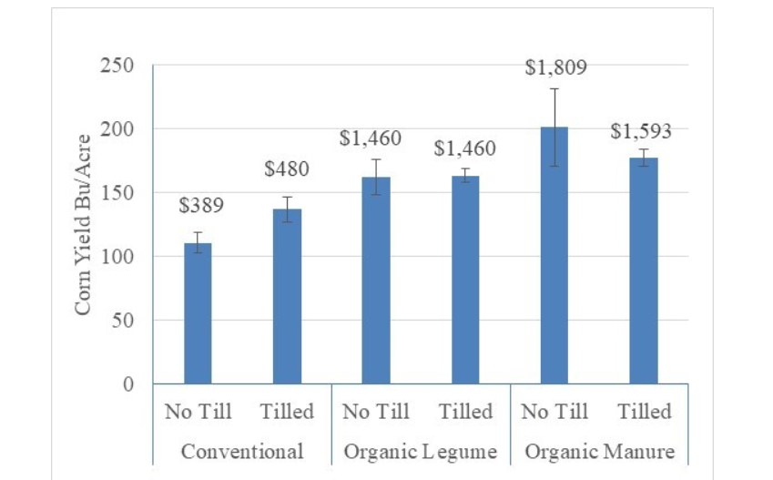
Benefits of RA: Improve Yields and Nutrition
Image: Soil Health Institute
Notes:
My Talking Points:
Benefit #3: RA Improves Yields and Nutrition.
These results per acre are based on farm trials by the Rodale Institute in Kutztown, PA over decades of testing.
Farm yields using No Till (no plowing) practices are competitive or better than conventional Tilled (plowing) methods after a 5-year transition period.
However, in extreme weather conditions, organic systems out-yield conventional up to 40% using 45% less energy and releasing 40% fewer carbon emissions.
Description of Rodale Institute Farm Trials.
Farming Systems Trial is located on 12 acres at our main campus in Kutztown, Pennsylvania. It is divided into 3 overarching systems: organic manure, organic legume, and conventional. Each system is further divided into two: tillage and no-till, for a total of 6 systems. There are a total of 72 experimental plots.
The Farming Systems Trial has also shown no statistically significant difference in yields between organic and conventional systems. In general, during years of adequate rainfall, there is no statistically significant difference in yields between organic and conventional systems. However, in years of extreme weather such as drought or flooding, and even years with less extreme weather like low rainfall, the organic systems out-yield conventional up to 40%. 2016 yields from the Farming Systems Trial. The organic manure system not only outperformed conventional but set a record for our county.
Rodale Institute Trial Data: https://rodaleinstitute.org/science/farming-systems-trial/#:~:text=Our%20decades%2Dlong%20research%20has,6x%20greater%20profits%20for%20farmers
OUR DECADES-LONG RESEARCH HAS SHOWN THAT ORGANIC SYSTEMS ARE COMPETITIVE WITH CONVENTIONAL YIELDS: AFTER A 5-YEAR TRANSITION PERIOD
PRODUCE YIELDS UP TO 40% HIGHER, IN TIMES OF DROUGHT EARN 3-6X GREATER PROFITS FOR FARMERS, LEACH NO TOXIC CHEMICALS INTO WATERWAYS,
USE 45% LESS ENERGY and RELEASE 40% FEWER CARBON EMISSIONS.

Slide 40
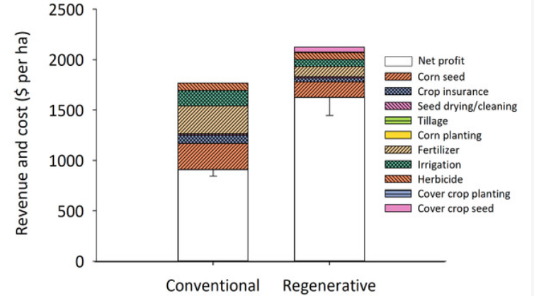
Benefits of RA: Greater Profits for Farmers
Image: Claire LaCanne and Joshua Lundgren, 2018.
Notes:
My Talking Points:
Benefit #4: RA Produces Greater Profits For Farmers.
This study of 20 farms showed that although crop yields were lower by 29%, RA systems had 70% higher profits than conventional methods.
The main reason for increase profits was due to using less inputs such as seed and fertilizer.
Added benefits included increased soil organic matter (SOM) and diversity of insects that decreased the number of harmful pests leading to stronger crops.
Discription: Benefits of RA: Greater Profits for Farmers
Regenerative corn fields generate nearly twice the profit of conventionally managed corn fields.
The heights of the bars represent average gross profits across all 40 fields (in each treatment). Profit was calculated using direct costs and revenues for each field and excludes any overhead and indirect expenses. Regenerative cornfields implemented three or more practices such as planting a multispecies cover mix, eliminating pesticide use, abandoning tillage, and integrating livestock onto the crop ground. Conventional cornfields used fewer than two of these practices. The regenerative systems had 70% higher profit than conventional cornfields (α = 0.05; n = 36 fields in each system). Seed drying, corn planting, and cover crop planting are present on the graphs, but were negligible costs.
Researchers from Ecdysis Foundation investigated how the move to more regenerative systems might affect yields, pests and profitability. The 20 farms in the review were ranked based on their implementation of regenerative agriculture practices. The researchers then looked at soil organic matter, pest presence, crop yield and profit.
Regenerative cornfields implemented three or more practices such as planting a multispecies cover mix, eliminating pesticide use, abandoning tillage, and integrating livestock onto the crop ground. Conventional cornfields used fewer than two of these practices. The regenerative systems had 70% higher profit than conventional cornfields
As expected, crop yields decreased in regenerative systems, and by 29%, no less. But while yield has served as the traditional metric of interest for farmers, that decrease in yield does not tell the whole story. The study found that the farms with regenerative practices were 70% more profitable than conventional plots. This increase in profitability was the result of two main factors: input costs and end markets.
Decreasing Input Costs
Regenerative agricultural systems, over time, require less external inputs, primarily in the form of seed and fertilizer. The research team observed an increase in soil organic matter. Soil organic matter decreases the need for external fertilizer by ensuring that necessary nutrients are available for crops. In fact, the team found that almost a third of farmers’ gross income went into external inputs on conventional fields, compared to 12% in regenerative fields.
But the benefits go beyond fertilizer costs. Increasing soil organic matter also increased the diversity of insects found in the soil. Insect diversity has been shown to decrease harmful pest abundance in cornfields, leading to stronger crops. Artem Milinchuk, Founder and CEO of FarmTogether. January 30, 2020.
Research: LaCanne CE, Lundgren JG. 2018. Regenerative agriculture: merging farming and natural resource conservation profitably. PeerJ 6:e4428 https://doi.org/10.7717/peerj.4428
https://www.ncbi.nlm.nih.gov/pmc/articles/PMC5831153/

Slide 41
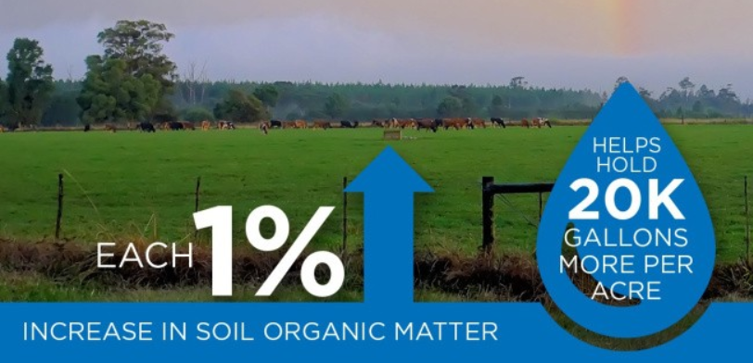
Benefits of RA: Create Drought - and Flood - Resistant Soil
Image: Kiss the Ground,
Notes:
My Talking Points:
Benefit #5: RA Creates Drought and Flood Resistant Soil.
Soil Organic Matter (SOM) determines the rate and quantity of surface water infiltration to reduce runoff and soil erosion during extreme weather conditions.
Each 1% of SOM holds up to 20,000 gallons more water per acre.
Most farmland today averages less that 3-4% SOM. This has caused severe soil erosion and fertilizer runoff pollution in many states. This makes it difficult to prevent crop loss during droughts and floods.
Soil Organic Matter (SOM) influences the physical conditions of a soil in several ways. Plant residues that cover the soil surface protect the soil from sealing and crusting by raindrop impact, thereby enhancing rainwater infiltration and reducing runoff. Surface infiltration depends on a number of factors including aggregation and stability, pore continuity and stability, the existence of cracks, and the soil surface condition. Increased organic matter contributes indirectly to soil porosity (via increased soil faunal activity). Fresh organic matter stimulates the activity of macrofauna such as earthworms, which create burrows lined with the glue-like secretion from their bodies and are intermittently filled with worm cast material.
The proportion of rainwater that infiltrates into the soil depends on the amount of soil cover provided (Figure 12). The figure shows that on bare soils (cover = 0 tonnes/ha) runoff and thus soil erosion is greater than when the soil is protected with mulch. Crop residues left on the soil surface lead to improved soil aggregation and porosity, and an increase in the number of macropores, and thus to greater infiltration rates.
Increased levels of organic matter and associated soil fauna lead to greater pore space with the immediate result that water infiltrates more readily and can be held in the soil (Roth, 1985). The improved pore space is a consequence of the bioturbating activities of earthworms and other macro-organisms and channels left in the soil by decayed plant roots.
On a site in southern Brazil, rainwater infiltration increased from 20 mm/h under conventional tillage to 45 mm/h under no tillage (Calegari, Darolt and Ferro, 1998). Over a long period, improved organic matter promoted good soil structure and macroporosity. Water infiltrates easily, similar to forest soils (Figure 13).
The consequence of increased water infiltration combined with a higher organic matter content is increased soil storage of water (Figure 14). Organic matter contributes to the stability of soil aggregates and pores through the bonding or adhesion properties of organic materials, such as bacterial waste products, organic gels, fungal hyphae and worm secretions and casts. Moreover, organic matter intimately mixed with mineral soil materials has a considerable influence in increasing moisture holding capacity. Especially in the topsoil, where the organic matter content is greater, more water can be stored. Regeneration Internnational.

Slide 42
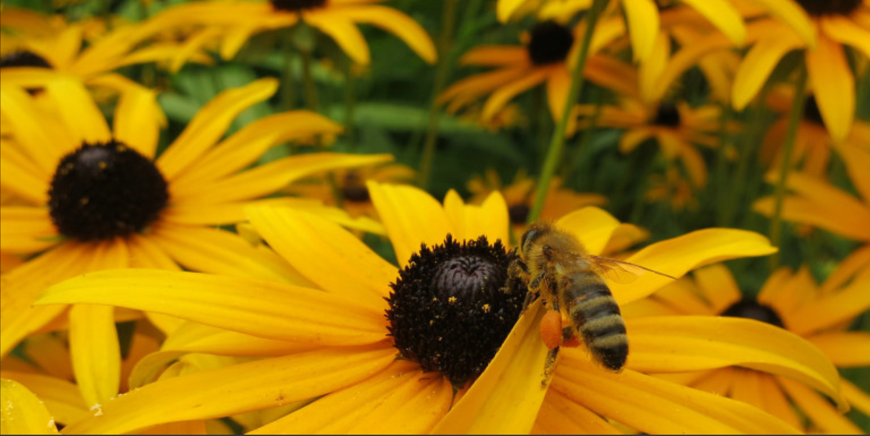
Benefits of RA: Nurture Biodiversity
Photo: Flickr/Ruth Hartnup. Data: Lori Ann Thrupp, Regeneration International
Notes:
My Talking Points:
Benefit #6: RA Nurtures Biodiversity.
Biodiversity is fundamental to agriculture production and food security.
The lack of biodiversity has resulted in reliance on monoculture crops that are highly susceptible to hot weather events, disease and pests as well as the loss of insects such as bees that are needed to pollinate our crops.
Just as important is the loss of microbes in our soil that are needed to create healthy soils, plants and animals.
“Biodiversity is fundamental to agricultural production and food security, as well as a valuable ingredient of environmental conservation. Yet predominant patterns of agricultural growth have eroded biodiversity in, for example, plant genetic resources, livestock, insects and soil organisms. This erosion has caused economic loss, jeopardizing productivity and food security, and leading to broader social costs. Equally alarming is the loss of biodiversity in “natural” habitats from the expansion of agricultural production to frontier areas
Biodiversity maintenance must be integrated with agricultural practices—a strategy that can have multiple ecological and socio-economic benefits, particularly to ensure food security. Practices that conserve, sustainably use and enhance biodiversity are necessary at all levels in farming systems, and are of critical importance for food production, livelihood security, health and the maintenance of ecosystems.” Lori Ann Thrupp, Regeneration International
Regenerative Agriculture practices restore biodiversity.

Slide 43
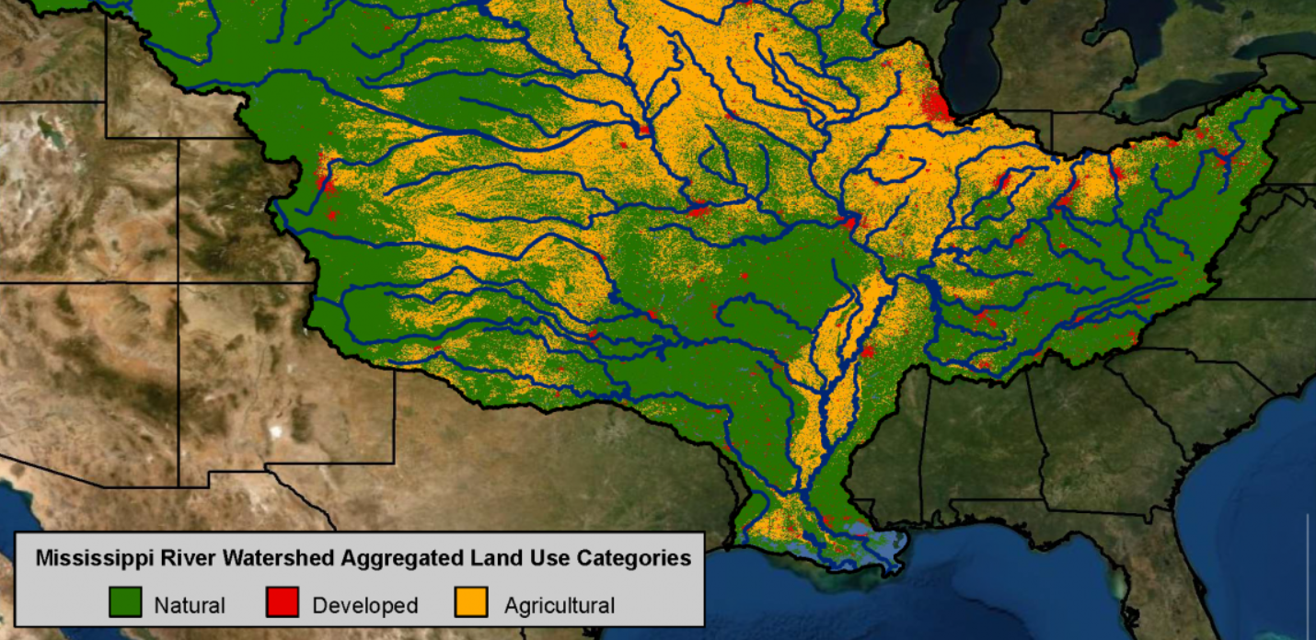
Benefits of RA: Protect Waterways
Image: NOAA
Notes:
My Talking Points:
Benefit #7: Last but not least, RA Protects Waterways.
RA practices increase water retention and decreases runoff pollution.
Clean water is one of the biggest environmental priorities of the world today.
Industrial agriculture is producing crisis level runoff pollutions that are devastating to our rivers, streams and oceans.
The Mississippi River Watershed crosses 22 states and carries nitrogen and phosphorus pollution runoff all the way to the Gulf of Mexico where it has created one of the largest toxic dead zones in the world (6,334 square miles).
“Clean water is one of the biggest environmental priorities in the world right now—it’s a critical resource that affects human health, biodiversity, and so much more. And it’s directly related to the way we grow our food.
Today, industrial agriculture is producing crisis levels of runoff—pollution that washes off farm fields after rain events and into our rivers, streams, and oceans. That runoff carries synthetic chemicals, fertilizers, and eroded soil that can contaminate waterways like the Delaware River, Chesapeake Bay, and Gulf of Mexico—threatening wildlife, our food supply, and drinking water.” Regeneration International
The Mississippi River watershed encompasses over 40% of the continental U.S and crosses 22 state boundaries. Nitrogen and phosphorus pollution in runoff and discharges from agricultural and urban areas are the major contributors to the annual summer hypoxic zone in the Gulf of Mexico. Source: Adapted from the USGS National Land Cover Dataset to show the three major land uses across the watershed; agriculture (yellow), developed lands (red), and natural lands (green). (NOAA, adapted from USGS National Land Cover Dataset)
Regenerative Agriculture practices such as cover cropping, reduced tillage, and year-round crops that increase water retention of the soil and also increase biodiversity, replacing the need for synthetic additives like pesticides and nitrogen and phosphorous applications, thereby decreasing any runoff into creeks, streams and rivers.

Slide 44
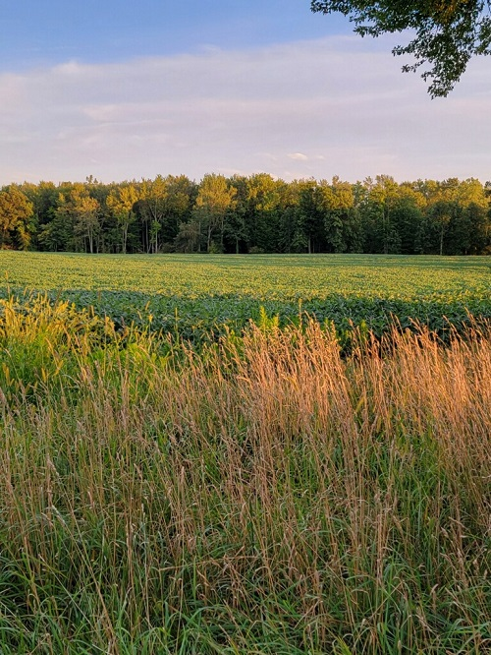
What Is The 2024 Farm Bill?
“The Farm Bill is an omnibus bill (meaning it covers many different areas of legislation) that governs much of the US food and agriculture system. With provisions for nutrition, crop insurance, conservation, rural investment, land access and more, the Farm Bill is one of the most important pieces of US legislation, and has considerable ramifications for farmer livelihoods, the environment, and national food security and access. Renewed every 5-7 years, the 2024 Farm Bill will last through at least 2029.” (From Regenerate America)
Regenerate America
Notes:
My Talking Points:
So, What is the 2024 Farm Bill?
This is a Quote from Regenerate America’s campaign website. They are part of Kiss The Ground’s coalition to promote new policies for the Farm Bill.
The 2024 Farm Bill covers many different areas of legislation dealing with the Agriculture system.
The Farm Bill is one of the most important pieces of legislation passed by Congress.
The total estimated cost of the new farm bill may be around 500 billion dollars over five years; over 1.3 trillion dollars over ten years.
It is renewed every five to seven years.
The next update is in 2024.
The Agriculture Improvement Act of 2018 (2018 Farm Act) consists of 12 titles governing a wide range of policy areas related to food and agriculture. The Congressional Budget Office (CBO) projected the total cost of the 2018 Farm Act would be $428 billion over the 5-year period 2019-2023.

Slide 45
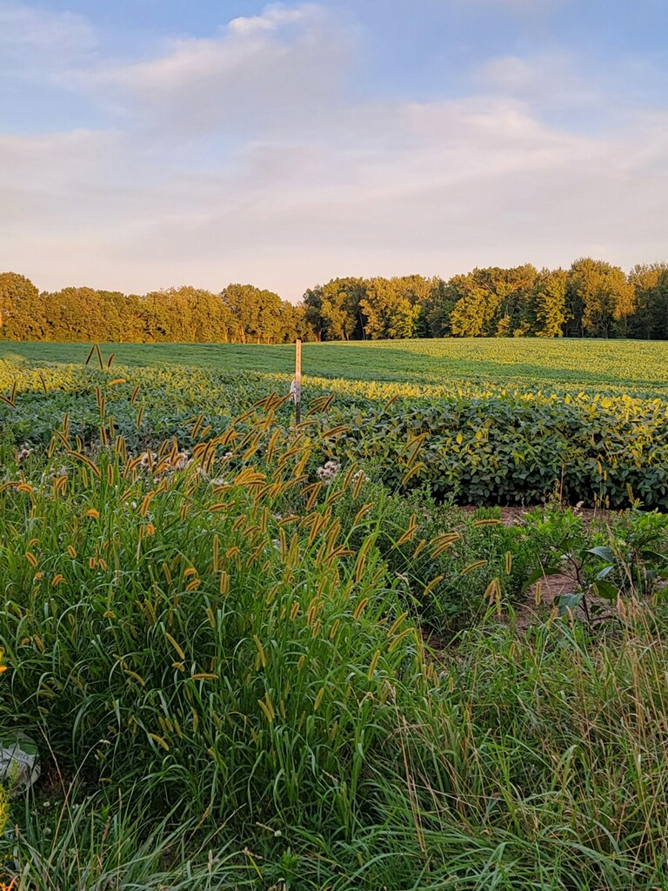
Areas Covered By The Farm Bill
The main areas covered by the Farm Bill:
Title I, Commodity Programs
Title II, Conservation
Title III, Trade
Title IV, Nutrition
Title V, Credit
Title VI, Rural
Title VII, Research, Extension, and Related Matters
Title VIII, Forestry
Title IX, Energy
Title X, Horticulture
Title XI, Crop Insurance
Title XII, Miscellaneous
Regenerate America
Notes:
My Talking Points:
The Farm Bill is composed of 12 Titles or areas as shown in this chart.
The Chicago Metro Chapter Regenerative Agriculture Campaign committee and the Climate Reality Project Regenerative Agriculture Coalition have created six Policy Recommendations for the 2024 Farm Bill that deal with several of these areas.
Climate Reality Project Leaders and Chapter members have held several meetings with Congressional staff Members of Congress advocating for these RA and Agrofoestry policies.
We hope Congress adds climate-smart agriculture policies to the new farm bill that reduce GHG emissions each year to help reverse global warming.

Slide 46
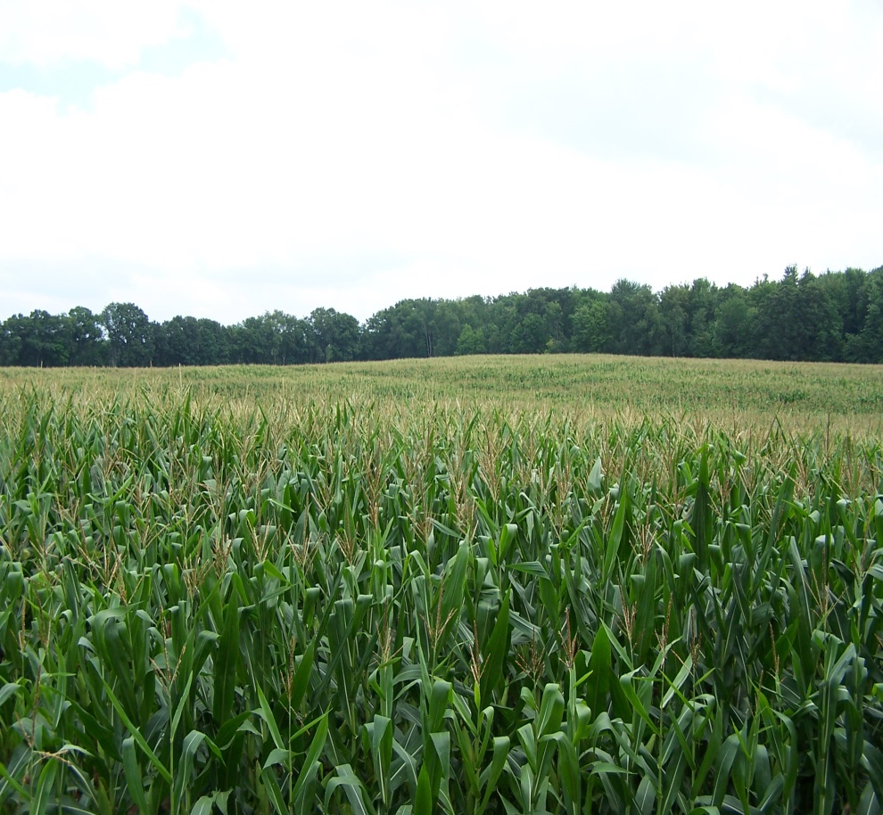
Top Reasons For Adding Regenerative Agriculture To 2024 Farm Bill!
Implement climate smart policies to mitigate climate change and meet UN emission reduction goals.
Stop industrial farming practices that are degrading our topsoil, and polluting our rivers, lakes and oceans.
Help farmers and ranchers reduce input costs and increase profits.
Increase crop yields in extreme weather conditions.
Increase nutrient values in our food supply.
Greatly reduce CO2 emissions by sequestering more carbon in our soil than we release into our atmosphere.
Climate Reality Project: Chicago Metro Chapter
Notes:
My Talking Points:
Here are our top reasons for adding Regenerative Agriculture policies to the 2024 Farm Bill.
Implement climate-smart policies to mitigate climate change and meet UN emission reduction goals.
Stop industrial farming practices that are degrading our topsoil, and polluting our rivers, lakes and oceans.
Help farmers and ranchers reduce input costs and increase profits.
Increase crop yields in extreme weather conditions.
Increase nutrient values in our food supply.
Greatly reduce CO2 emissions by sequestering more carbon in our soil than we release into our atmosphere.
All of these are important to us.
We need to stop the current farming practices that are harming our environment and emphasize the great potential of sequestering carbon back into our soil to reach Net-Zero CO2 emissions by 2040 or sooner.
We can do all of this with the new Farm Bill.

Slide 47
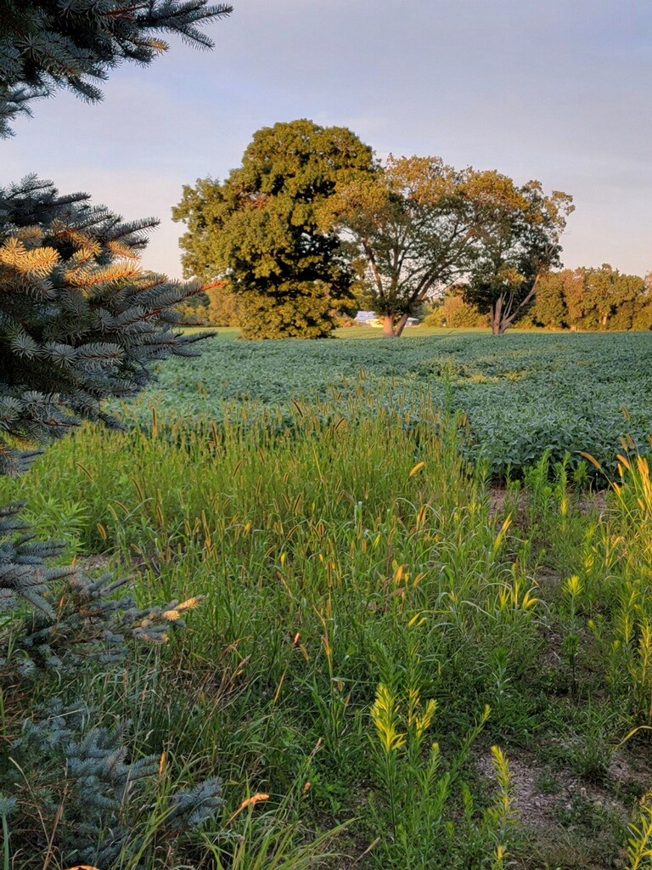
What You Can Do To Help
Promote RA solutions to build healthy soil and biodiversity.
Join our CRP RA Coalition movement to participate in events.
Join other RA Organizations to promote RA practices through action alerts and advocacy efforts.
Work to create awareness of RA’s potential to combat climate change.
Meet with Ag Committee Members and Members Of Congress to advocate for climate-smart farm bills.
Buy organic food products and support organic farmers.
With your help, we can make a real difference.
Climate Reality Project: Chicago Metro Chapter
Notes:
My Talking Points:
What you can do to help.
Promote RA solutions to build healthy soil and biodiversity.
Join our CRP RA Coalition movement to participate in events.
Join other RA Organizations to promote RA practices through action alerts and advocacy efforts.
Work to create awareness of RA’s potential to combat climate change.
Meet with Ag Committee Members and Members Of Congress to advocate for climate-smart farm bills.
Buy organic food products and support organic farmers.
With your help, we can make a real difference.

Slide 48
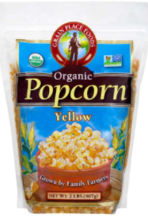
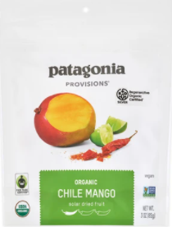
How Individuals Can Regenerate: Shop ROC Products
Companies Pioneering ROC Goods
Alexandre Family Farms
Apricot Lane Farms
Dr. Bronner’s Soaps
Grain Place Foods
Guayaki
Lotus Foods
Nature’s Path
Patagonia Provisions
Thrive Market
Photos: Patagonia Provisions, General Mills
Notes:
My Talking Points:
How can individuals help?
Support regenerative farmers by looking for companies and foods that contain the Regenerative Organic Certified (ROC) label.
Here are some products to look for in stores.
Regenerative Organic Certified was established in 2017 by a group of farmers, business leaders, and experts in soil health, animal welfare, and social fairness collectively called the Regenerative Organic Alliance, or ROA.
We exist to heal a broken system, repair a damaged planet, and empower farmers and eaters to create a better future through regenerative organic farming.
By adopting regenerative organic practices on more farms around the world, we can create long-term solutions to the climate crisis, factory farming, and fractured rural economies.

Slide 49
Notes:
My Talking Points:
Here are more things you can do; Ask questions at farmer markets:
Do you grow organic crops?
Are your crops diversified?
Do you use no-till, cover crops or other RA methods to grow crops?
Do you use synthetic fertilizers or pesticides?
Do you use rotational animal grazing methods?
Are you ROC certified?

Slide 50
Notes:
My Talking Points:
Finally, Educate Yourself About RA:
Here are some names of organizations you can check out on your own.
They have numerous educational documents, videos, training material and case studies on regenerative farmers and ranchers.
Once empowered, you can contact your legislators and tell them what can be done to stop, and even reverse, climate change.

Slide 51
Farmer and Rancher Outreach Campaign
Please fill out our survey questionnaire to tell your success stories to members of Congress regarding the 2024 Farm Bill and Inflation Reduction Act.
Climate Reality Project Regenerative Agriculture Coalition
Notes:
My Talking Points:
The Climate Reality Project Regenerative Agriculture Coalition has started a new campaign reaching out to farmers and ranchers to gather perspectives on agricultural policies that are shaping the future of farming and ranching.
We are asking them to fill out a short questionnaire. It takes a few minutes, but their responses will be invaluable. We're interested in their views on conservation agriculture, soil management techniques, and the potential impacts of these new policies on their farm or ranch.

Slide 52
Farmer and Rancher Outreach Campaign
Climate Reality Project Regenerative Agriculture Coalition is looking for farmers and ranchers who wish to tell their success stories using regenerative practices to members of Congress regarding the 2024 Farm Bill and funding for the Inflation Reduction Act.
Click on this link for the survey: https://forms.gle/J6icZu92sG72zAZs7
Climate Reality Project Regenerative Agriculture Coalition
Notes:
My Talking Points:
We are asking farmers and ranchers to tell their success stories using RA practices to members of Congress regarding the 2024 Farm Bill and funding in the Inflation Reduction Act
It will help us advocate more effectively for policies that support farmers and the environment.
Feel free to pass on this survey to any farmers and ranchers who would like to participate.
Here is the link for the survey: https://forms.gle/J6icZu92sG72zAZs7

Slide 53
Regenerate America Video
Regenerate America
Notes:
My Talking Points:
To end this presentation, I would like to show you a recent YouTube trailer from Regenerate America on RA.
I think you will find this video inspirational.
While you watch the video, I will review any questions in the Chat and try to answer them during Q & A.
Link: (374) Regenerate America™ Trailer 2022 – YouTube
https://www.youtube.com/watch?v=0x3335g76gE&t=46s

Slide 54
Q & A
Send your questions to my email at viecelli@comcast.net
Notes:
Questions & Answers.
Thank you for allowing me the opportunity to talk to you today.
This completes my presentation on Regenerative Agriculture – Best Tool For Combating Climate Change.
I will now take questions. Please raise hands on the Zoom screen.
For Questions I can not answer, I will get back to you promptly if you leave your email contact information in the Chat.
You can also send me your Questions to my email address: viecelli@comcast.net, and I will get back to you.
Thank you.

